Slide 1

Welcome to our coffee morning!
^{17th June 2024}
Notes:
1

Slide 2
Augmentative and Alternative communication.
What is augmentative and alternative communication (AAC)?
Why use AAC?
Different types of AAC
How can it benefit children?
Link to AAC
Take home ‘communication’ resource pack including:
  Makaton finger spelling chart.
  play communication aids.
Notes:
2

Slide 3
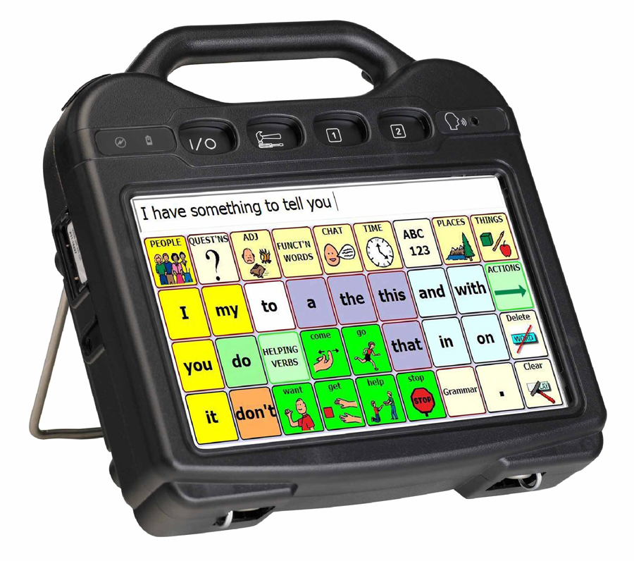
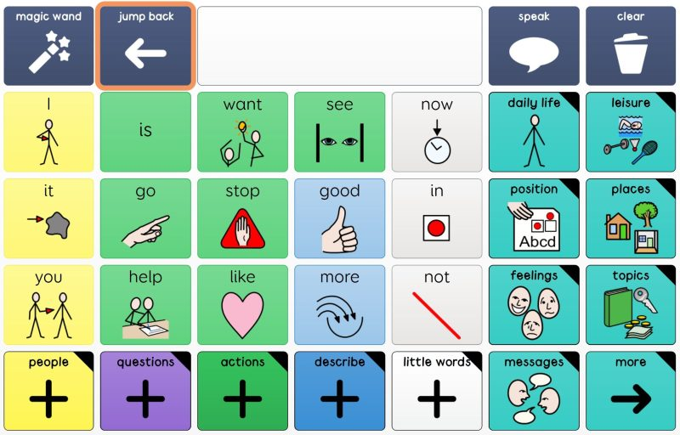
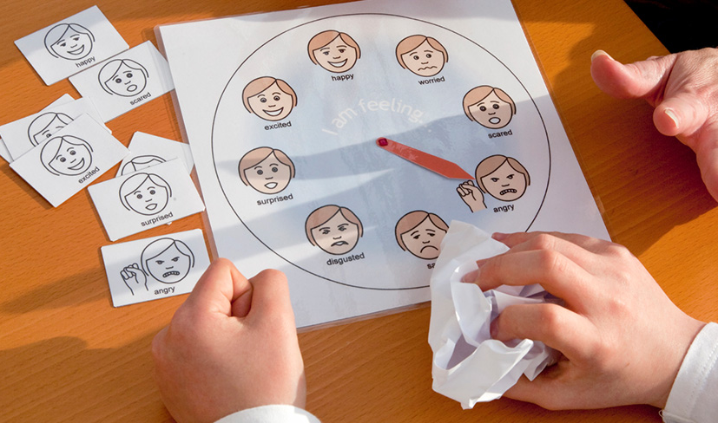
What is Augmentative & Alternative Communication (AAC)
Augmentative and alternative communication (AAC) refers to the use of objects, symbols, charts, photographs, signing and electronic aids to help a child communicate.
These are used by children and young people when they have difficulties with producing or understanding written or spoken language.
Notes:
3

Slide 4
Why use AAC?
AAC may be used for a variety of reasons.
  As a bridge or stopgap: to help a child communicate whilst their speech and language skills are developing.
  To help a child make sense of spoken language.
  To supplement their spoken skills: to be used alongside speech to help the child make themselves understood.
  As an alternate means of communication: because of the nature of their difficulties, some children are always likely to struggle with spoken communication. AAC can give them a voice, and therefore some control over their environment.
  As a tool to develop language skills: to give the child experience of building their language skills, e.g. forming sentences when they can only produce sounds or single words themselves.
Notes:
4

Slide 5
Different types of AAC
Some examples of different communication systems include:
  Eye pointing frames: used with photographs, line drawings, symbols etc.
  Communication books or charts.
  Electronic communication aids.
  British sign language or signing systems such as Makaton.
  Switches.
  PODD books.
  Picture exchange communication systems.
Notes:
5

Slide 6
How can it benefit children?
Children with a range of difficulties can benefit from different types of AAC. Not all children will require electronic devices, but many will benefit from signing, symbols and communication books.
Children able to benefit from more sophisticated technology can have integrated systems that enable the child to use personal computers.
Notes:
6

Slide 7
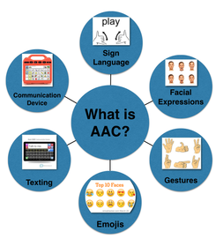
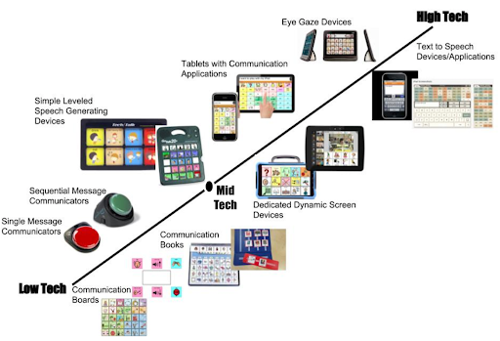
Rachael Lethbridge - AAC
https://www.cornwall.gov.uk/schools-and-education/special-educational-needs/send-support-services/augmentative-and-alternative-communication/
Notes:
7

