Slide 1

Autumn Home learning for EYFS/KS1 Learners
Nicky Rowland
Remember its important to email me and post photographs on the parent group so we can see what amazing work you have been doing

Slide 2
Learning Area | Slide | Activity ideas with learning opportunities
Sensory/Physical Social/Emotional | 3,6,7,8, 14 | These are the instrumental tunes we have been listening too whilst relaxing. Explore some dry leaves/coloured tissue paper/chiffons/material. Massage your child and share interaction. Hold an umbrella up and let the leaves/materials tip off it. Walking in the forest – get your childs’ shoes and socks off and talk about the body parts. Find some soft toys/different textures if possible to feel/reach for. Walk and stomp feet on a metal tray. Move your child's legs fast/slow. Encourage 1,2,3 go/ready steady go. Go on a leaf hunt outside.
Early Cognition | 6,9,10 | Think about the movements and your child hearing your spoken words - ‘up/down/around/fast slow. Do they visually track the items, respond – change body position. Counting the leaves together and sorting/matching 1,2,3
Communication and Interaction | 11 12 17 & 18 Topic story massage *Harvest songs we have been listening too are included and our hello song (19). | Reading for pleasure – Shared attention, listening/looking Call and response – repeat key words, follow the prompts, encourage their own sounds, explore where possible objects you can find relating to parts of the story. Collect some items as you go on introducing them gradually as you repeat the story building on awareness, anticipation, vocalisations, pointing to pictures, symbols.

Slide 3

Autumn song - guitar

Slide 4
Harvest Samba sign along

Slide 5
Let’s Harvest

Slide 6
Sensory Autumn – calm

Slide 7
Sensory Autumn – visual

Slide 8
Sensory Autumn – piano

Slide 9
Baby Jake Autumn

Slide 10
Autumn Mr tumble - colours

Slide 11
How many leaves – number

Slide 12
We’re going on a leaf hunt story

Slide 13
Sensory story call and response

Slide 14
Walking in the forest - song

Slide 15
Harvest - Cauliflowers fluffy

Slide 16
Signing - Cauliflowers fluffy

Slide 17
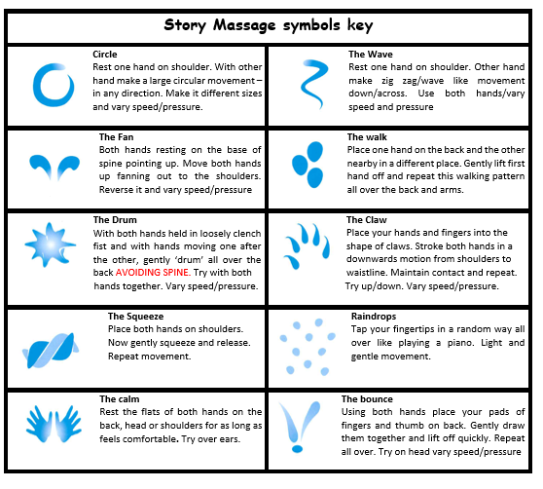
Story massage
In ‘Little Acorns’ we use story massage because it combines the benefits of positive touch with fun and creativity of words – whether this is as a story, rhyme or song. It’s great to do at home too!

Slide 18
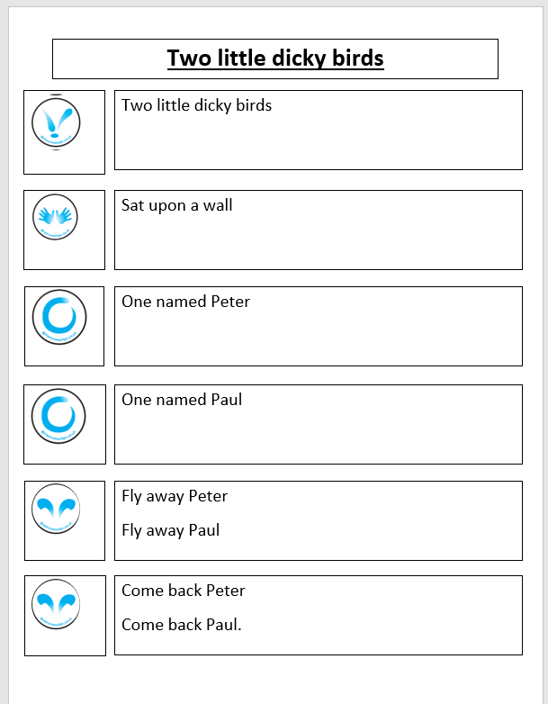
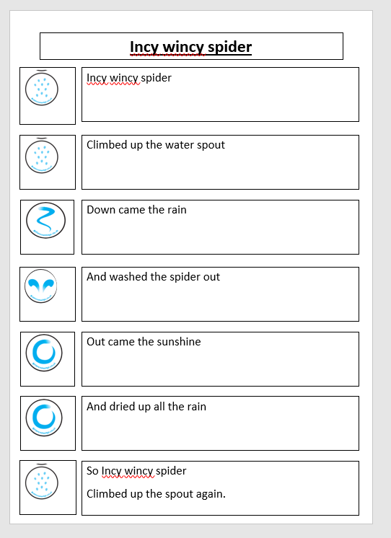

Slide 19
Hello song we are all getting familiar with –
Who is in the room?

