Slide 1
English – 21.10.21
WALT: talk about books
WILF:
listen to a story
answer simple questions about a story
talk about my favourite story

Slide 2
Good Morning,
Today I am going to share one of my favourite stories with you.
Whilst I am reading the story I would like you to think about the books you have at home.
Do you have a favourite story?
Would you like to share this story with us today and tell us why its your favourite?

Slide 4
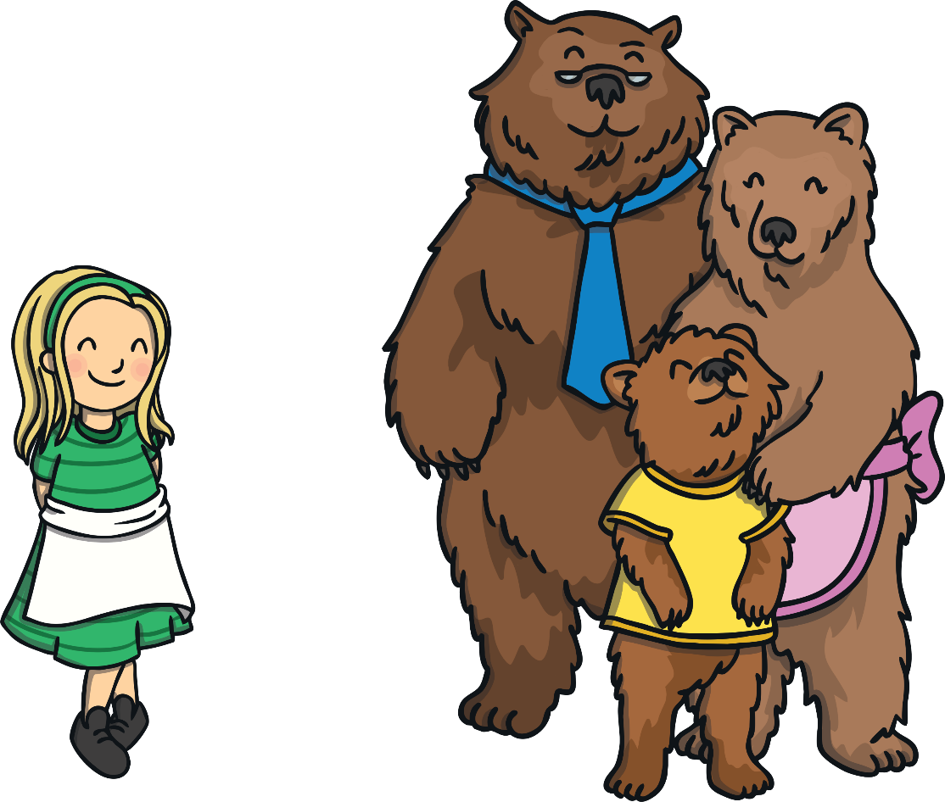
Once upon a time lived Goldilocks and The Three Bears.

Slide 5
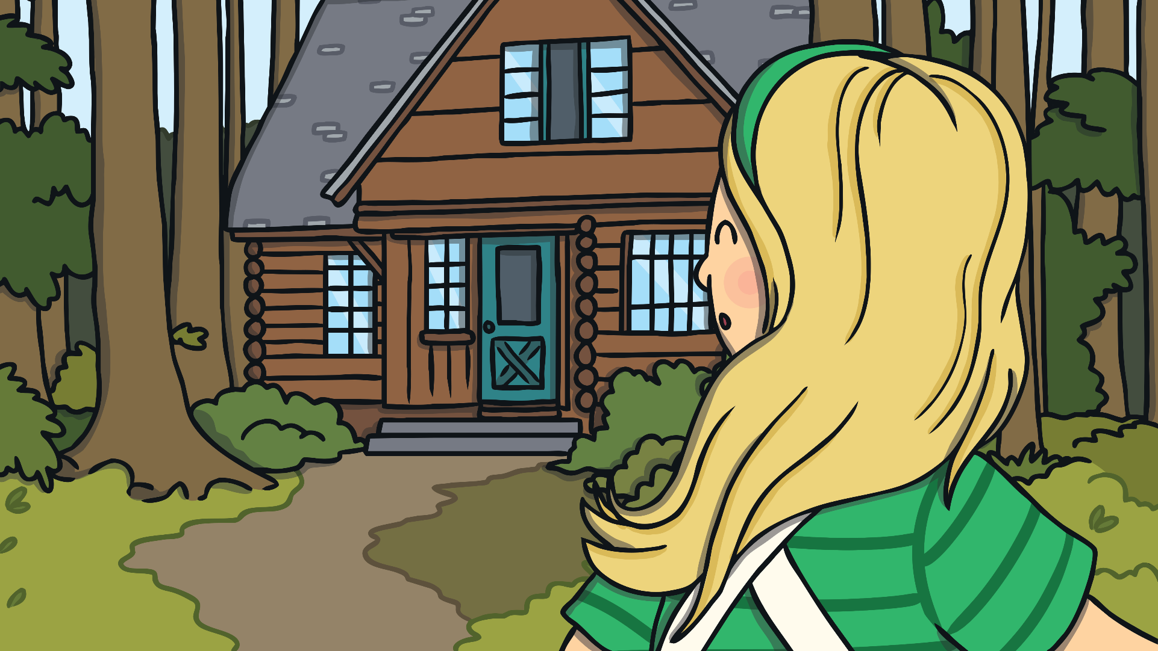
One day, Goldilocks went for a walk in the forest and found a house. She knocked, and when nobody answered, she decided to go inside.

Slide 6
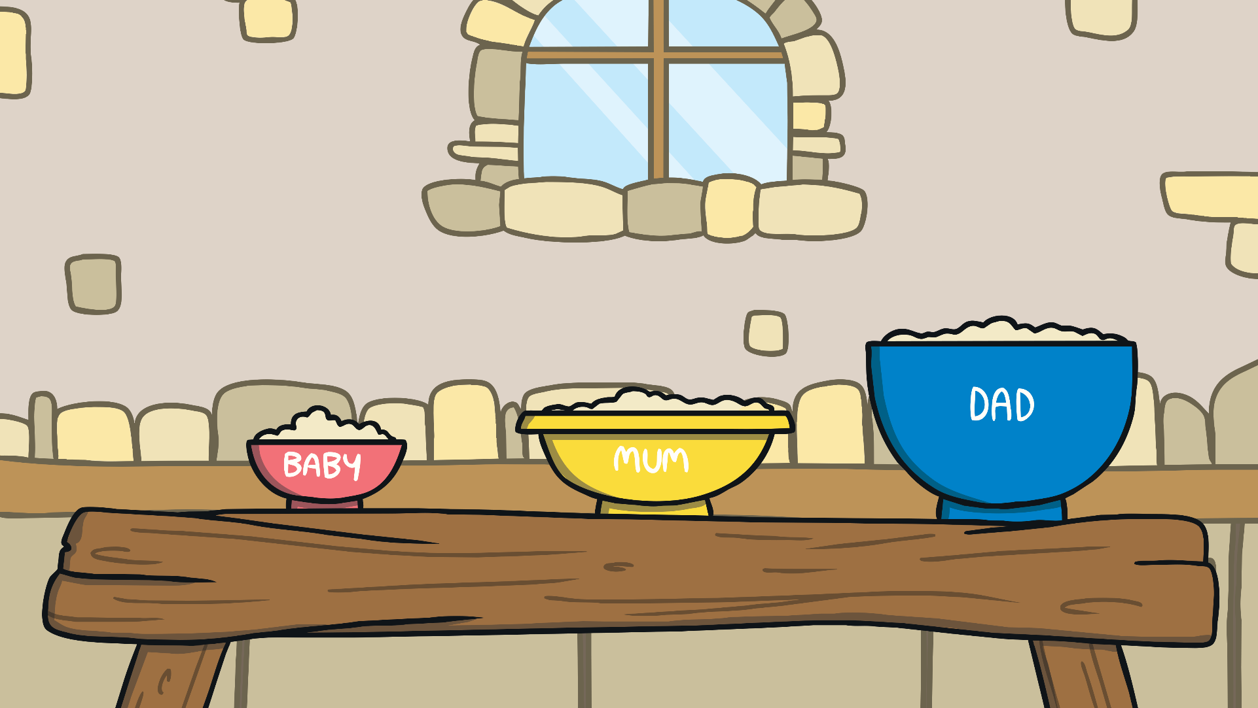
At the table, there were three bowls of porridge. Goldilocks was hungry.

Slide 7
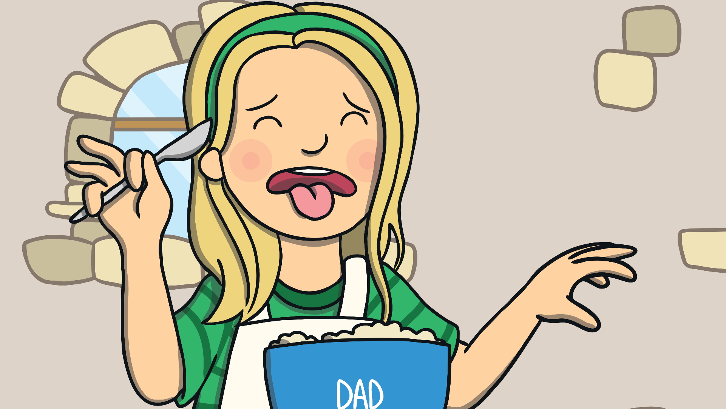
She tasted the porridge from the large bowl. “This porridge is too salty!” she said.

Slide 8
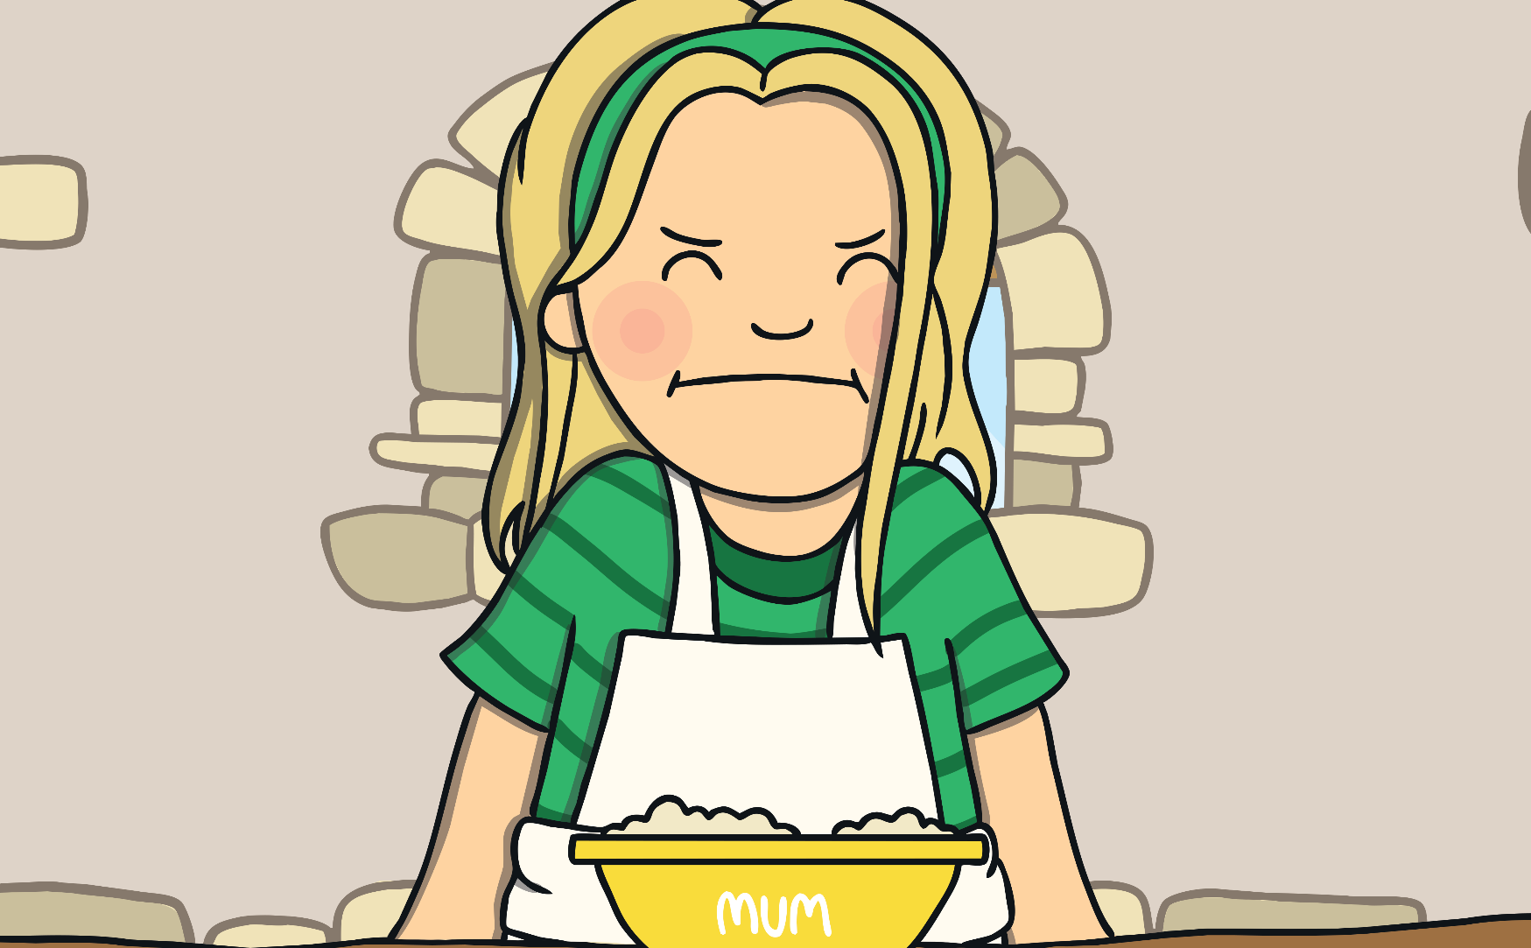
She tasted the porridge from the medium sized bowl. “This porridge is too sweet!” she said.

Slide 9
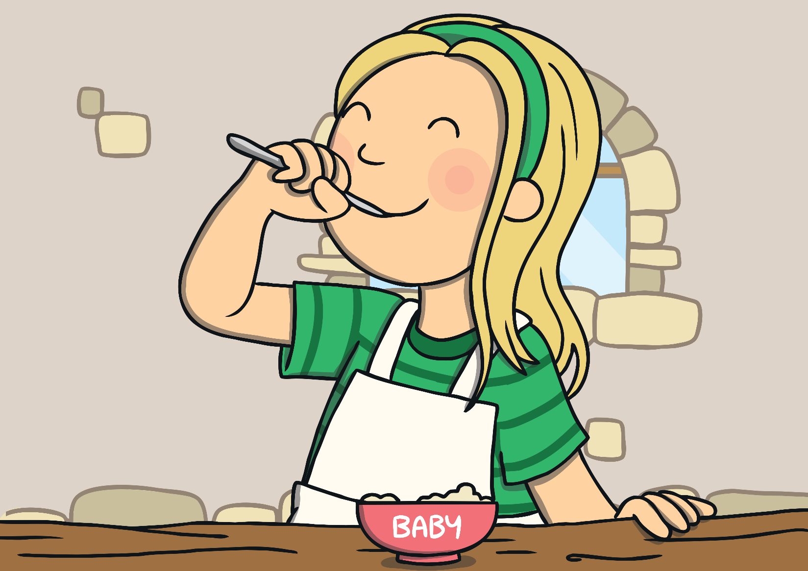
She tasted the porridge from the small bowl. “This porridge is just right,” she said and she ate it all up.

Slide 10
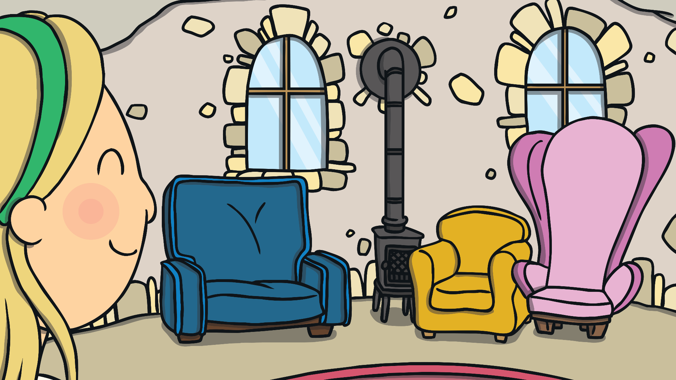
Goldilocks felt tired, so she walked into the living room and saw three chairs.

Slide 11
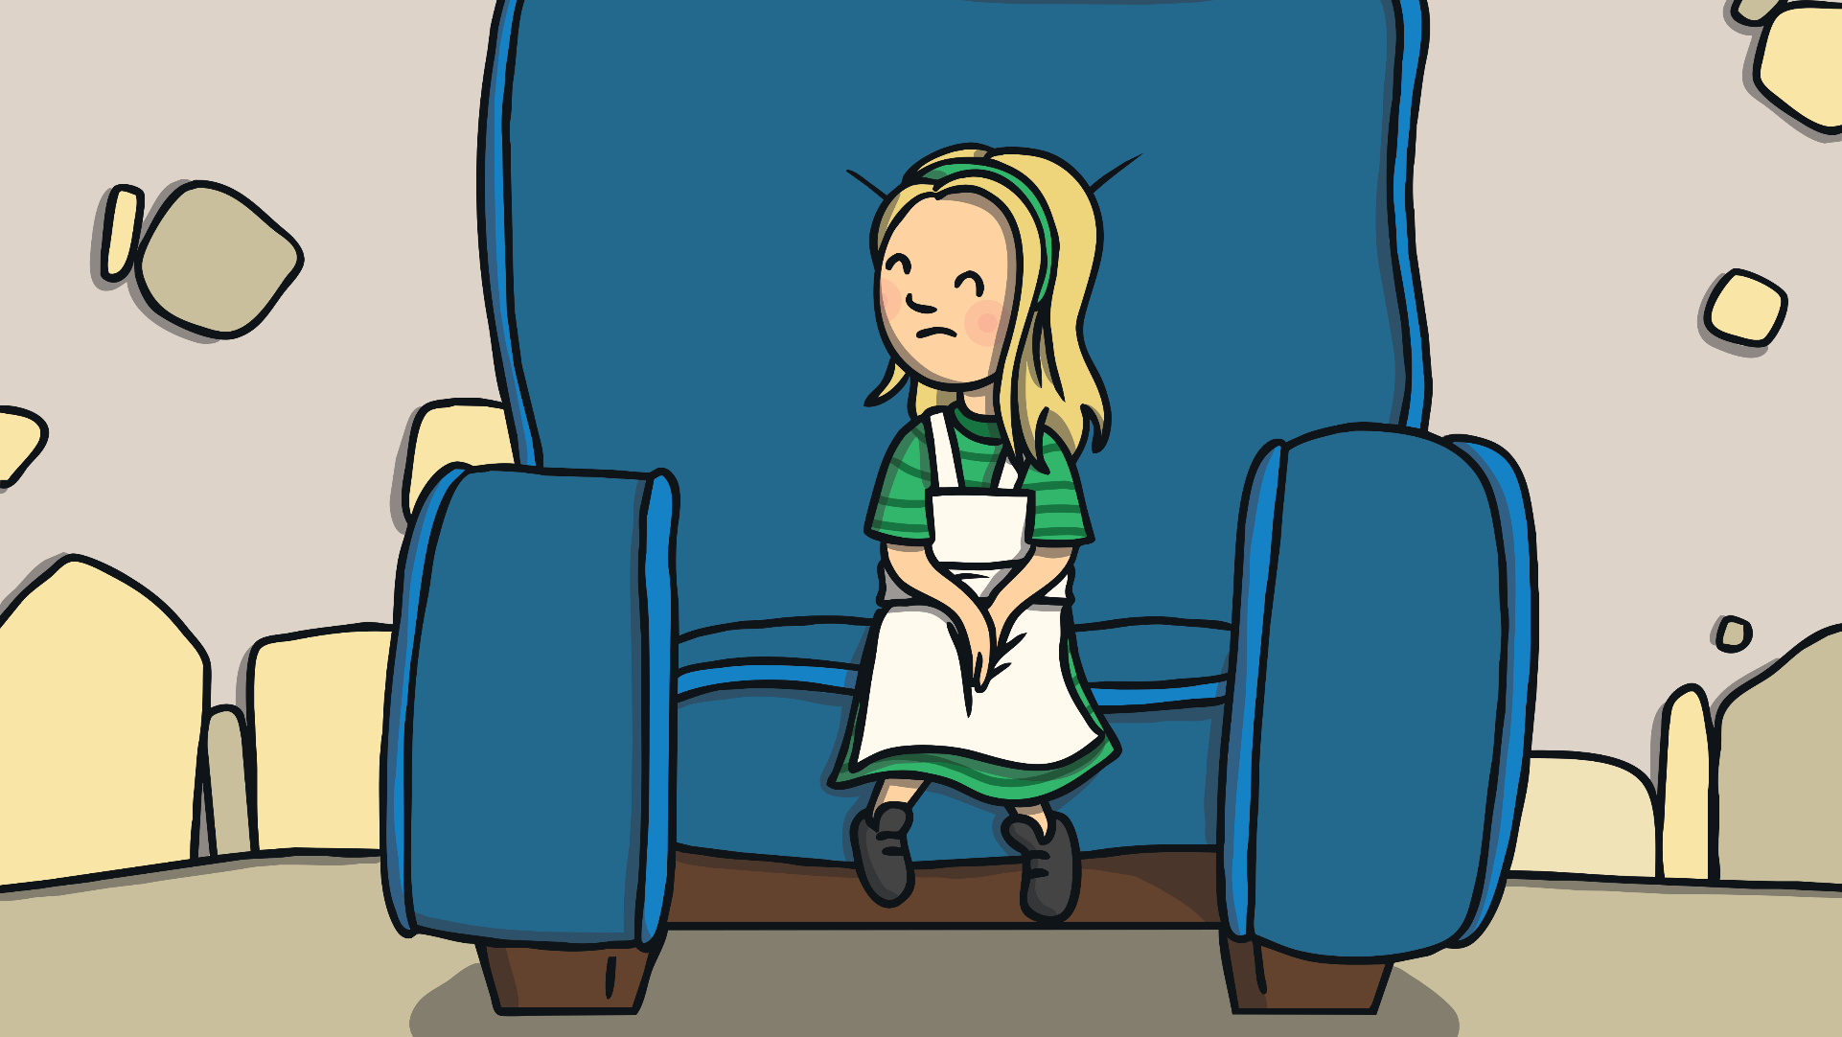
She sat in the large chair to rest her feet. “This chair is too big!” she said.

Slide 12
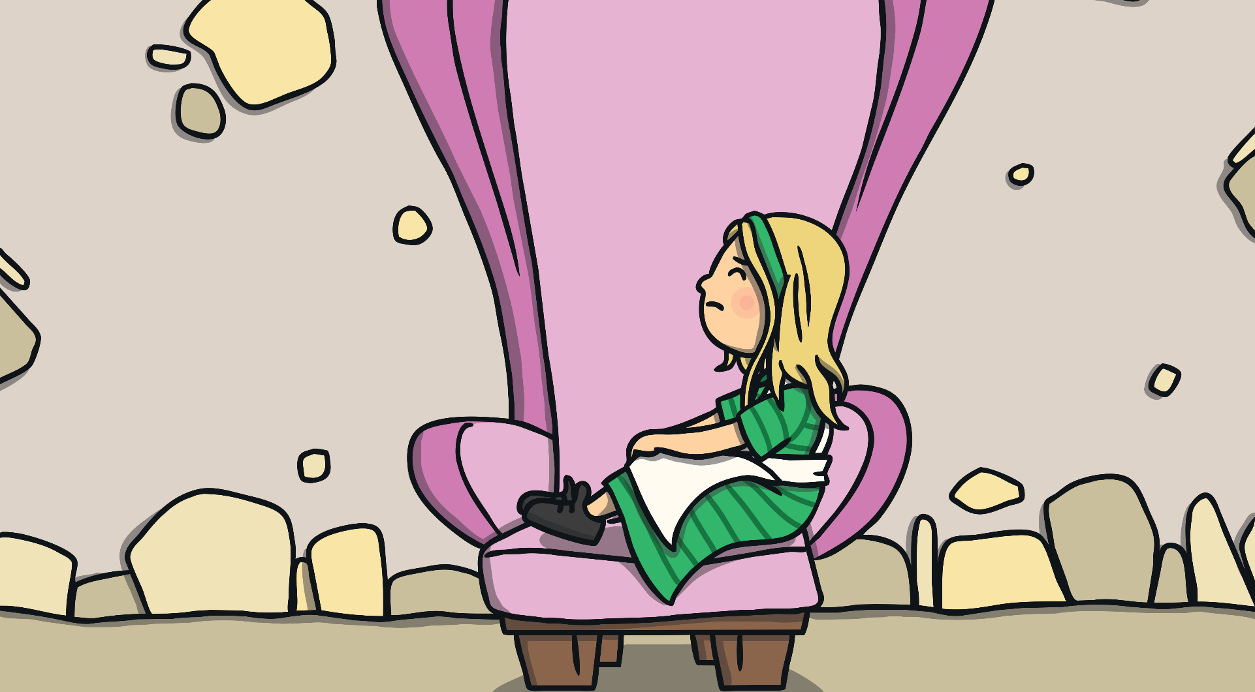
She sat in the medium sized chair. “This chair is too big, too!” she said.

Slide 13
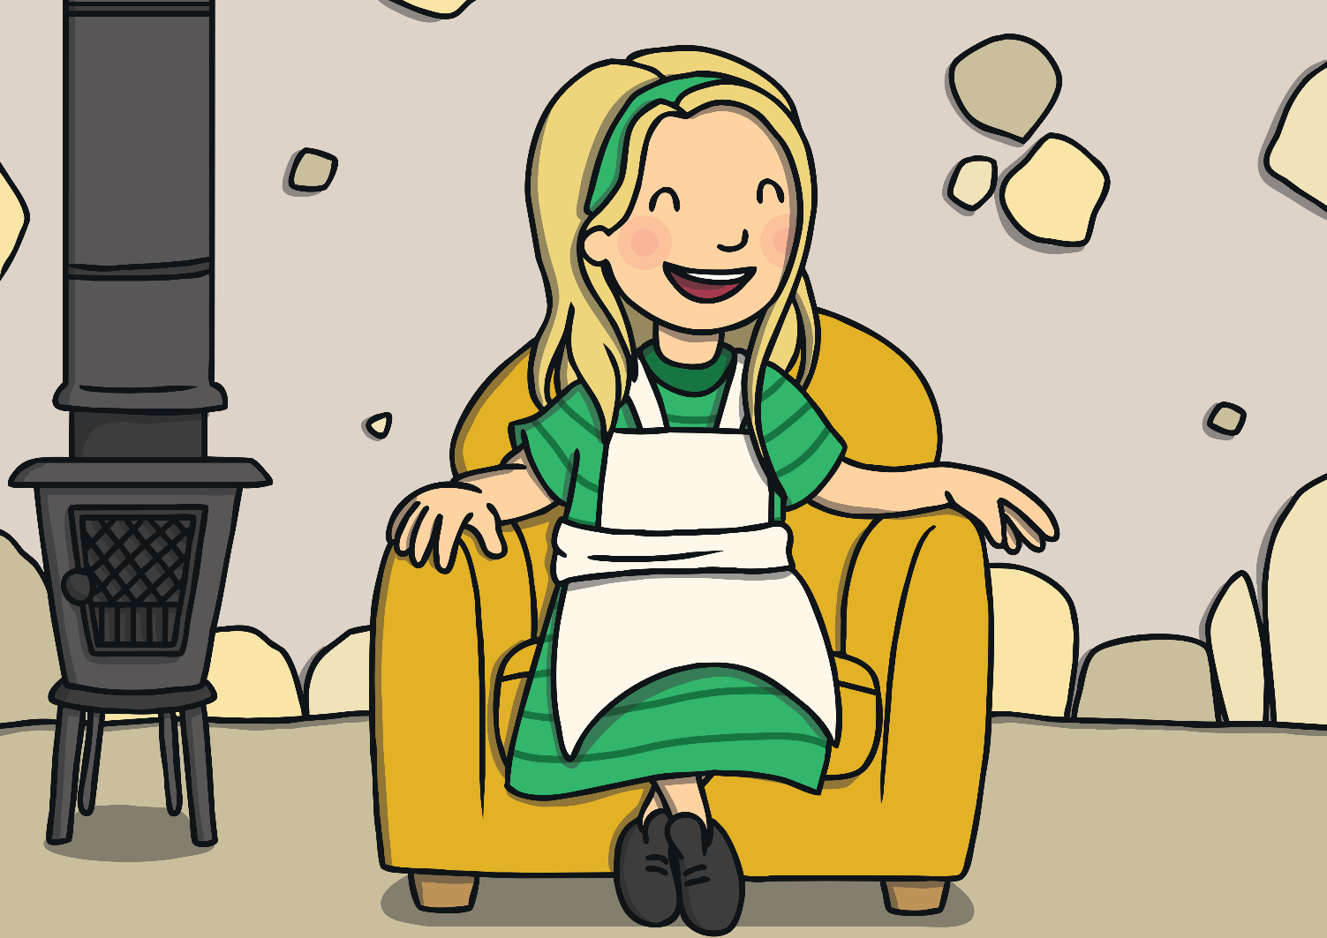
She sat in the small chair. “This chair is just right,” she sighed.

Slide 14
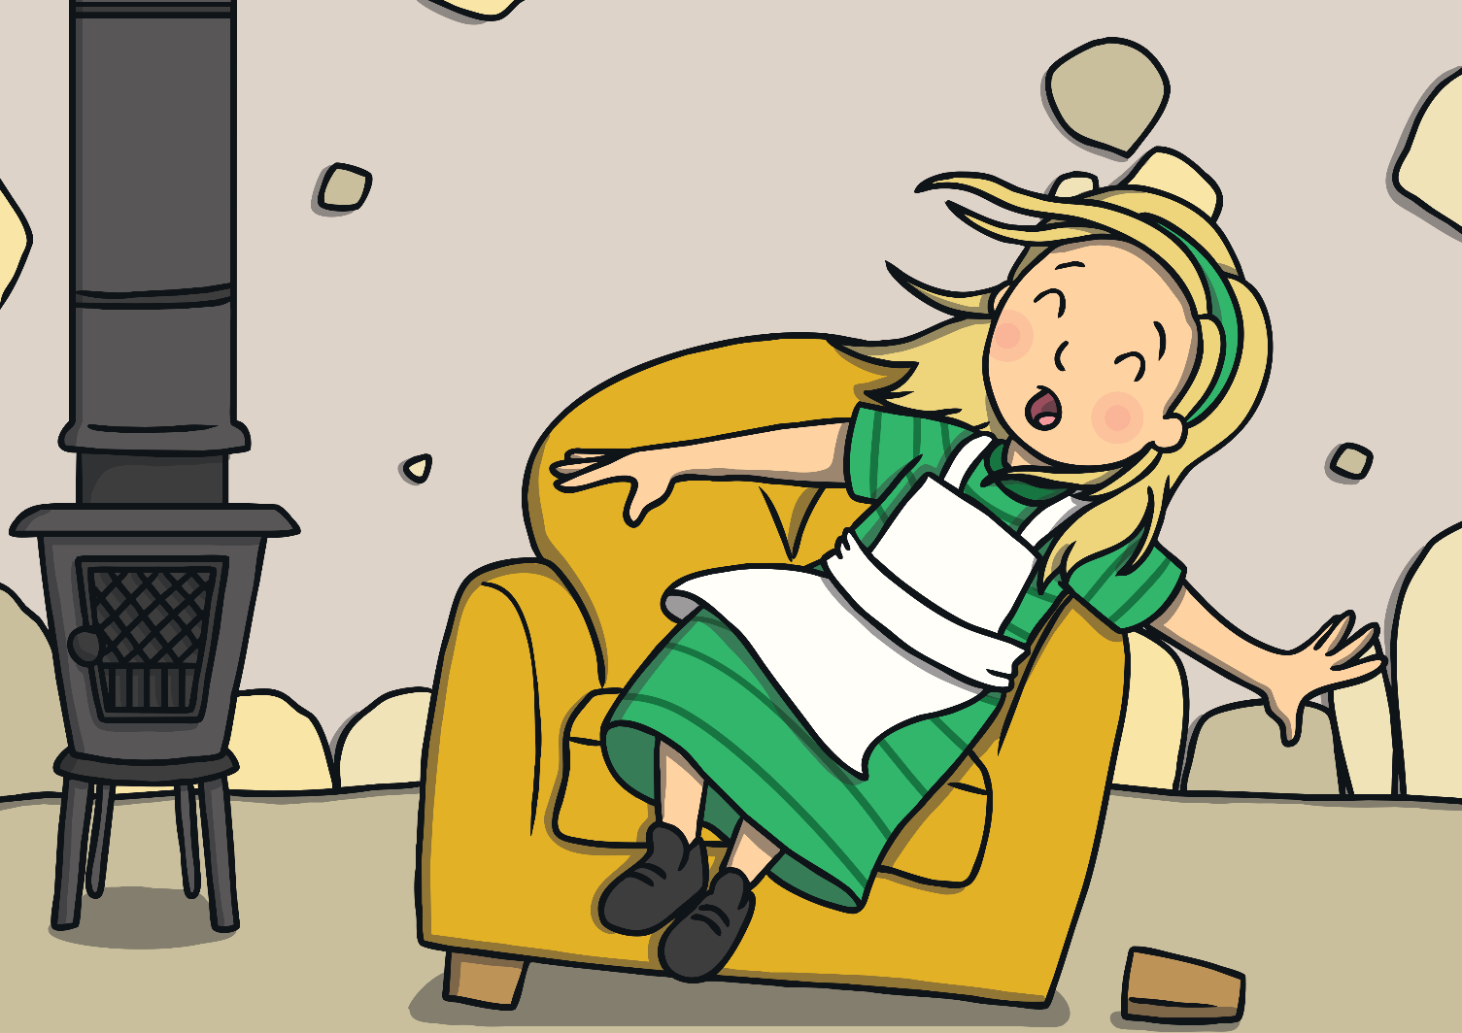
Just as Goldilocks settled down into the chair to rest, it broke into pieces!

Slide 15
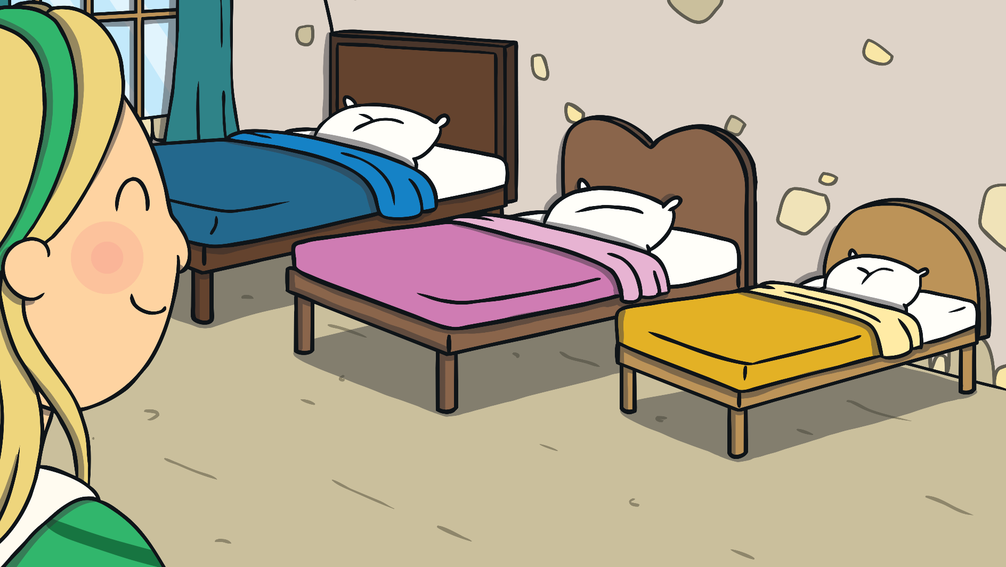
By now, Goldilocks was very tired, so she went upstairs to the bedroom.

Slide 16
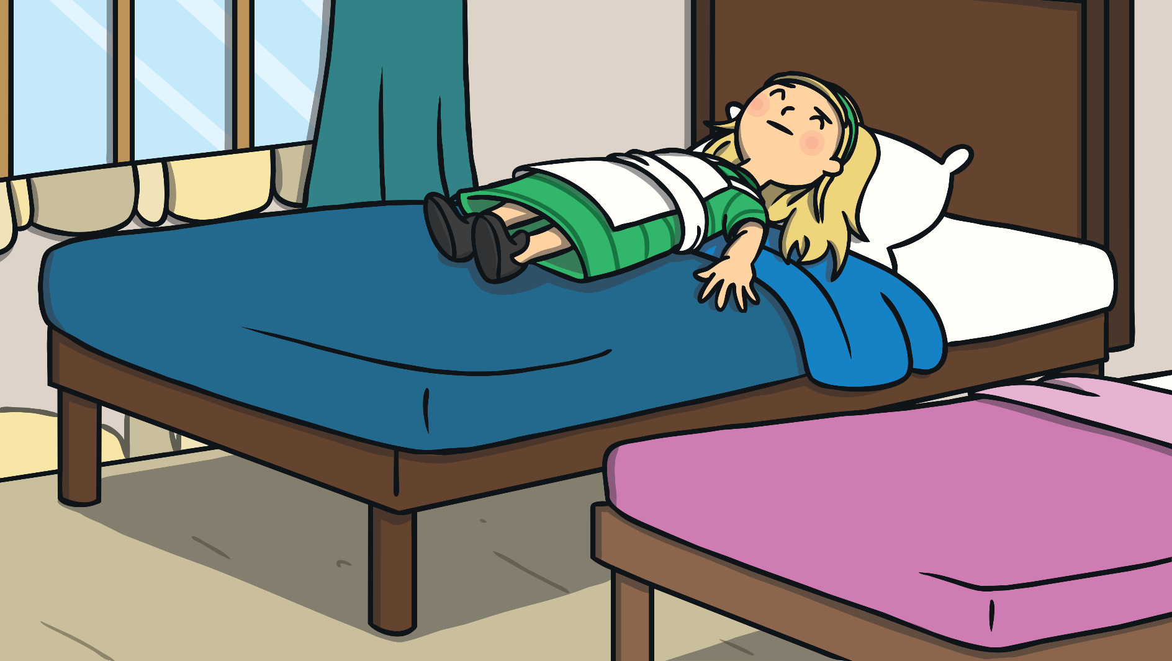
She lay down on the large bed. “This bed is too hard!” she said.

Slide 17
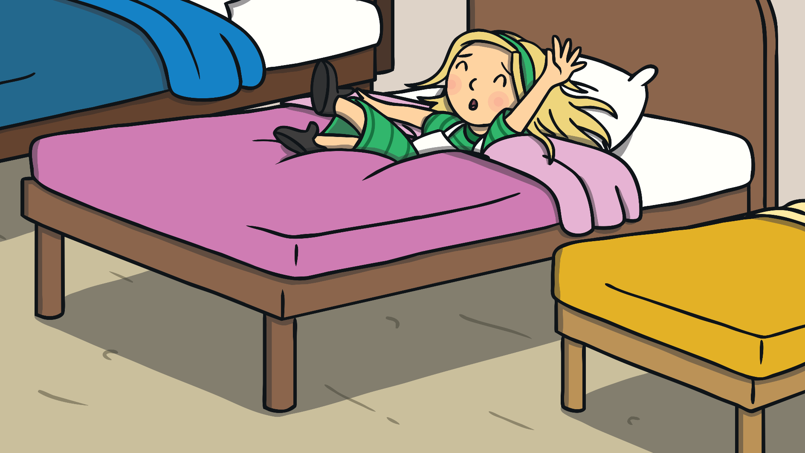
She lay down on the medium sized bed. "This bed is too soft!" she said.

Slide 18
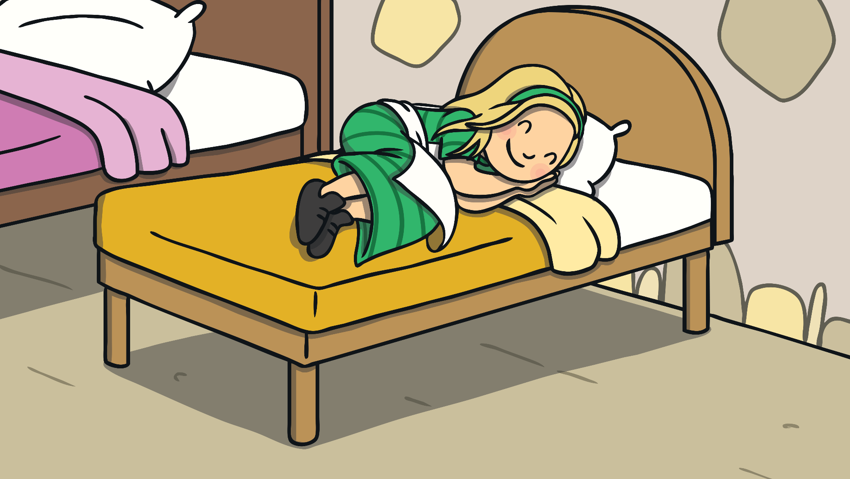
She lay down on the small bed. "This bed is just right," she sighed. She curled up and fell asleep.

Slide 19
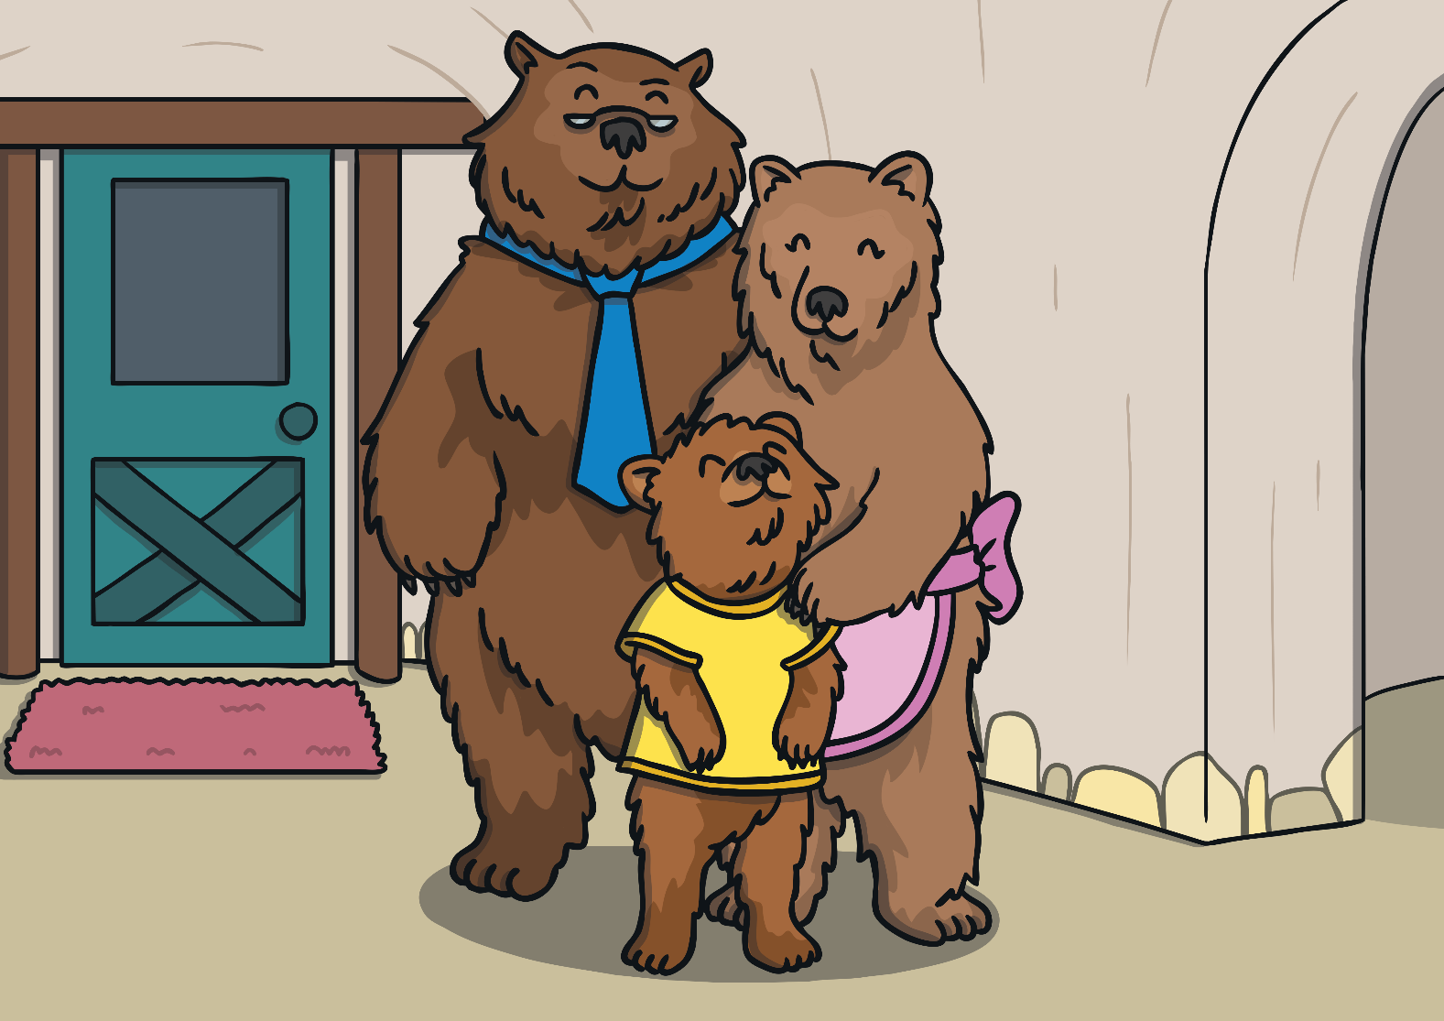
As she was sleeping, The Three Bears came home.

Slide 20
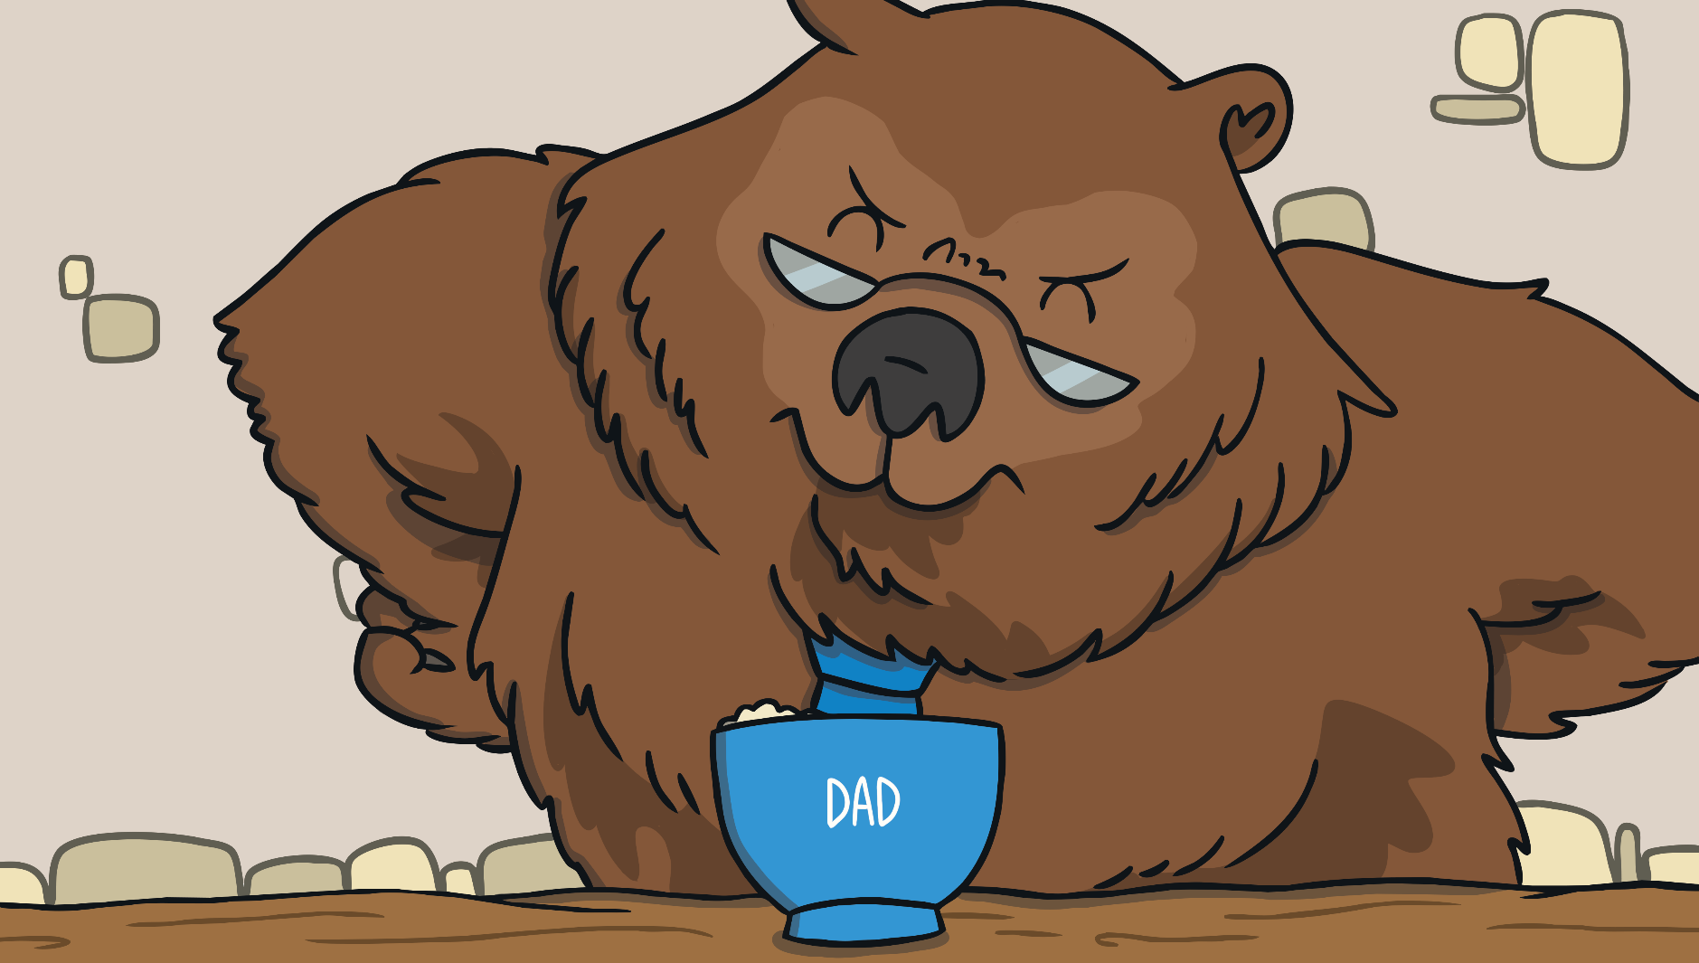
“Someone’s been eating my porridge,” growled
Daddy Bear.

Slide 21
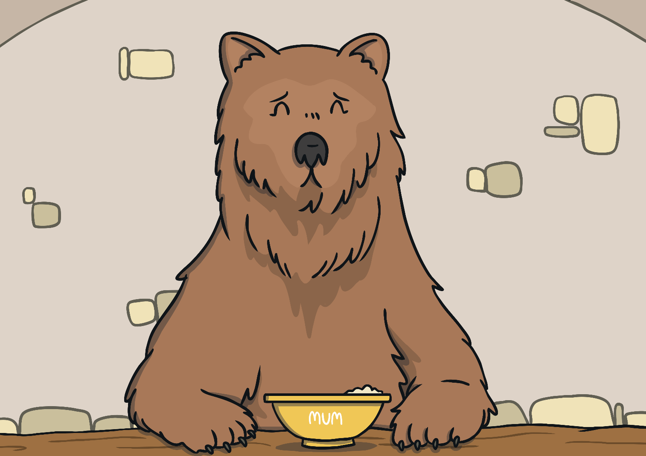
“Someone’s been eating my porridge,” said
Mummy Bear.

Slide 22
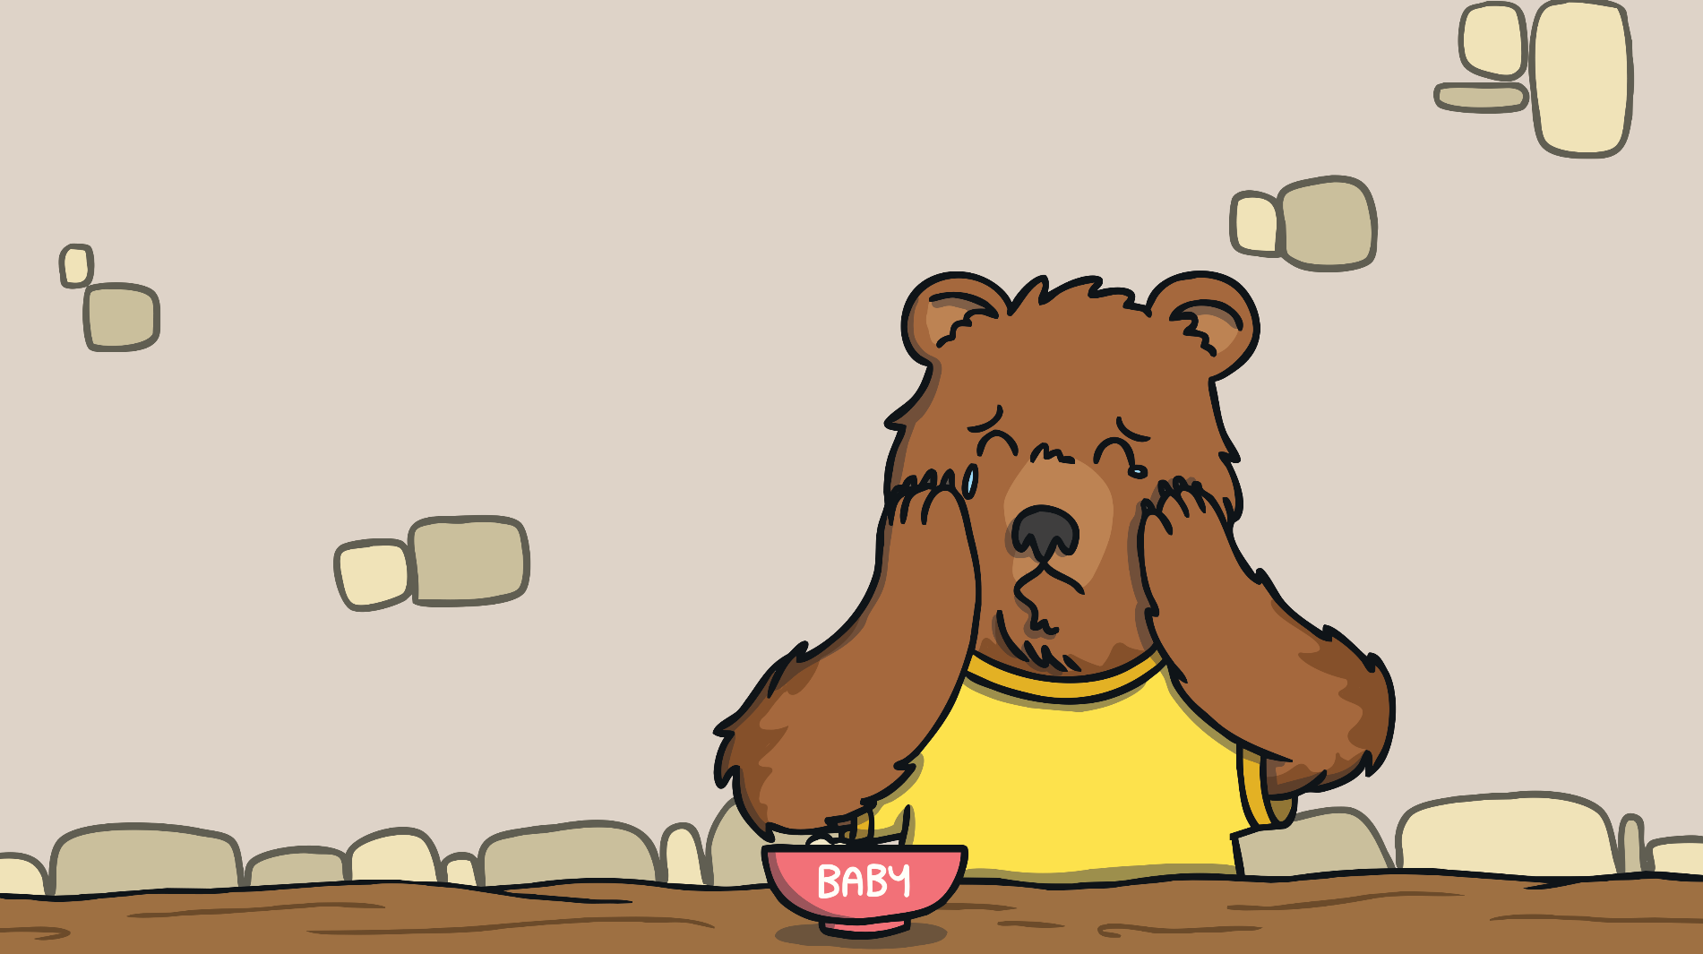
“Someone’s been eating my porridge and it’s all gone!” cried Baby Bear.

Slide 23
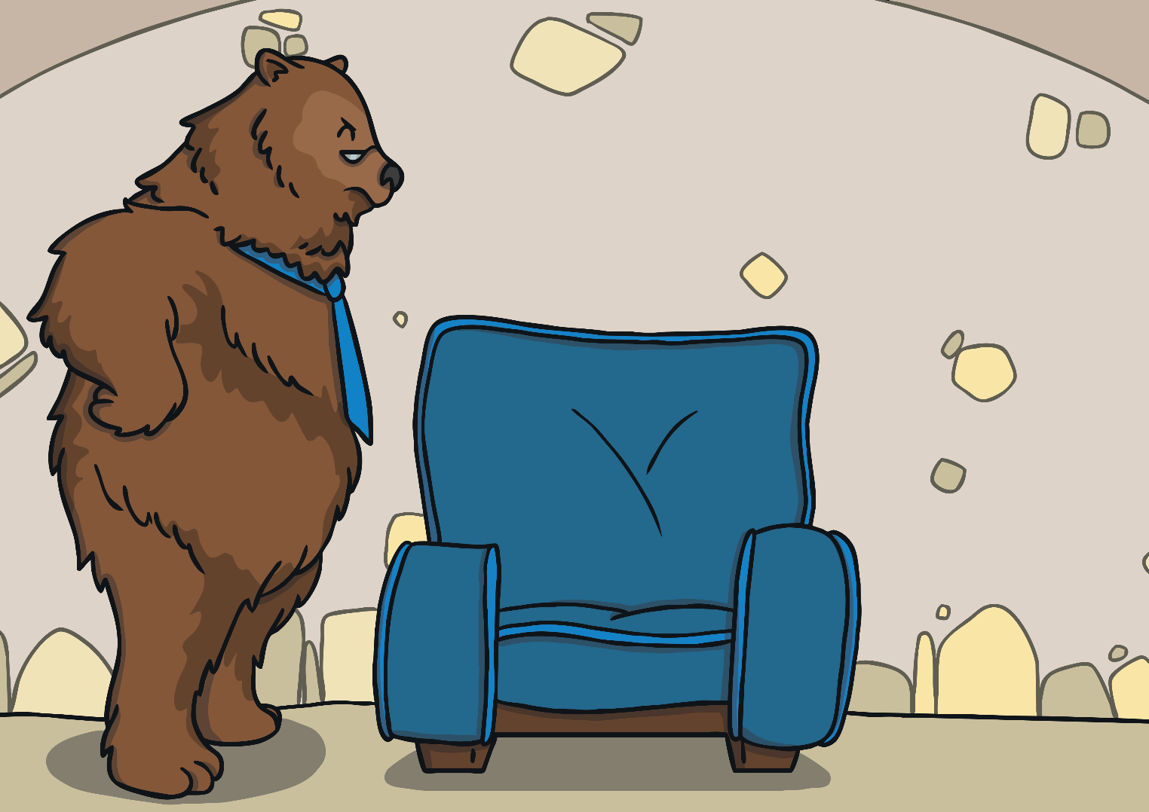
“Someone’s been sitting in my chair!” growled
Daddy Bear.

Slide 24
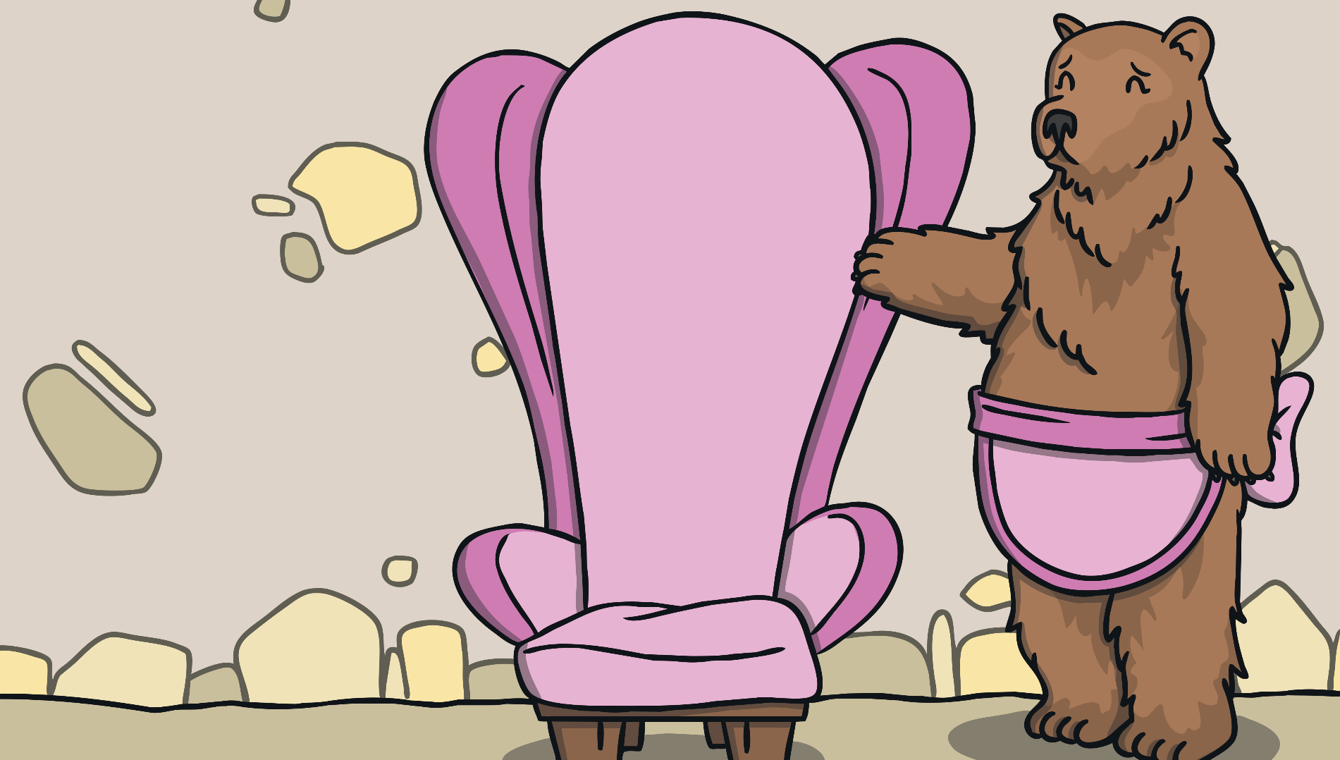
“Someone’s been sitting in my chair!” said
Mummy Bear.

Slide 25
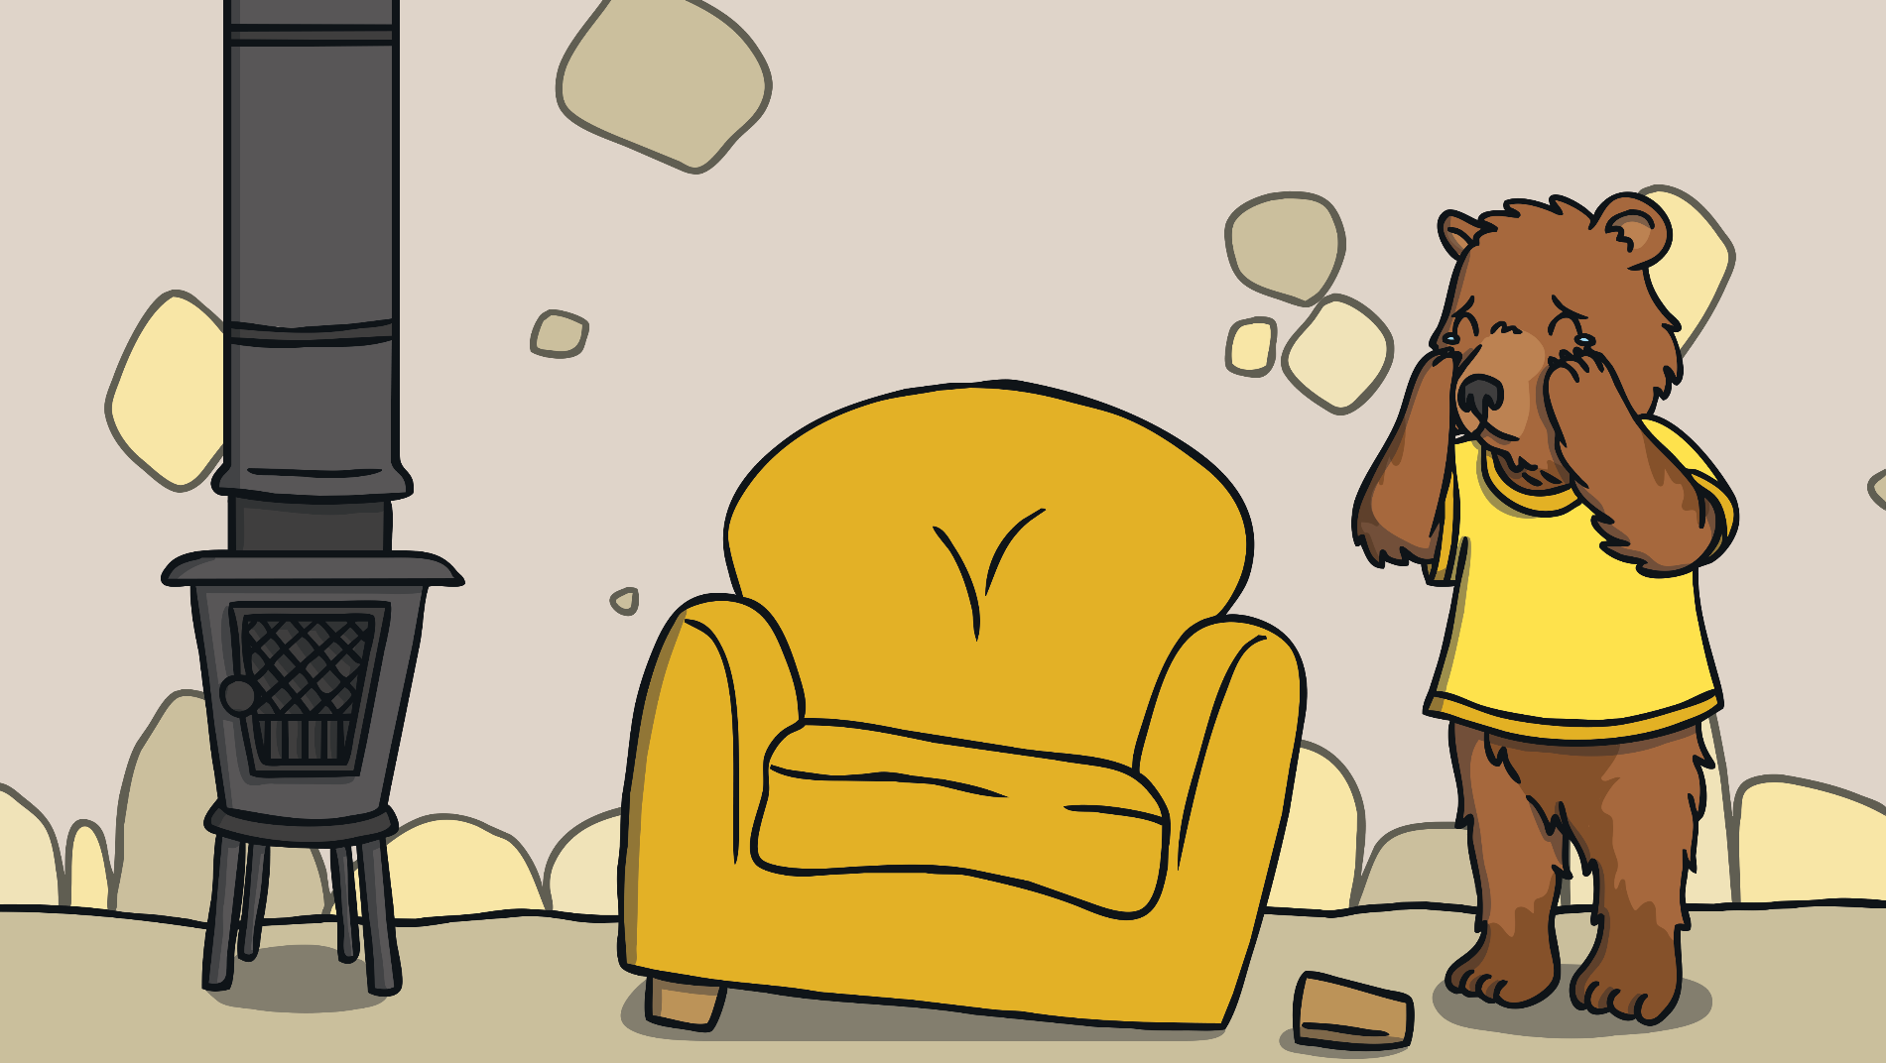
“Someone’s been sitting in my chair and it’s broken!” cried Baby Bear.

Slide 26
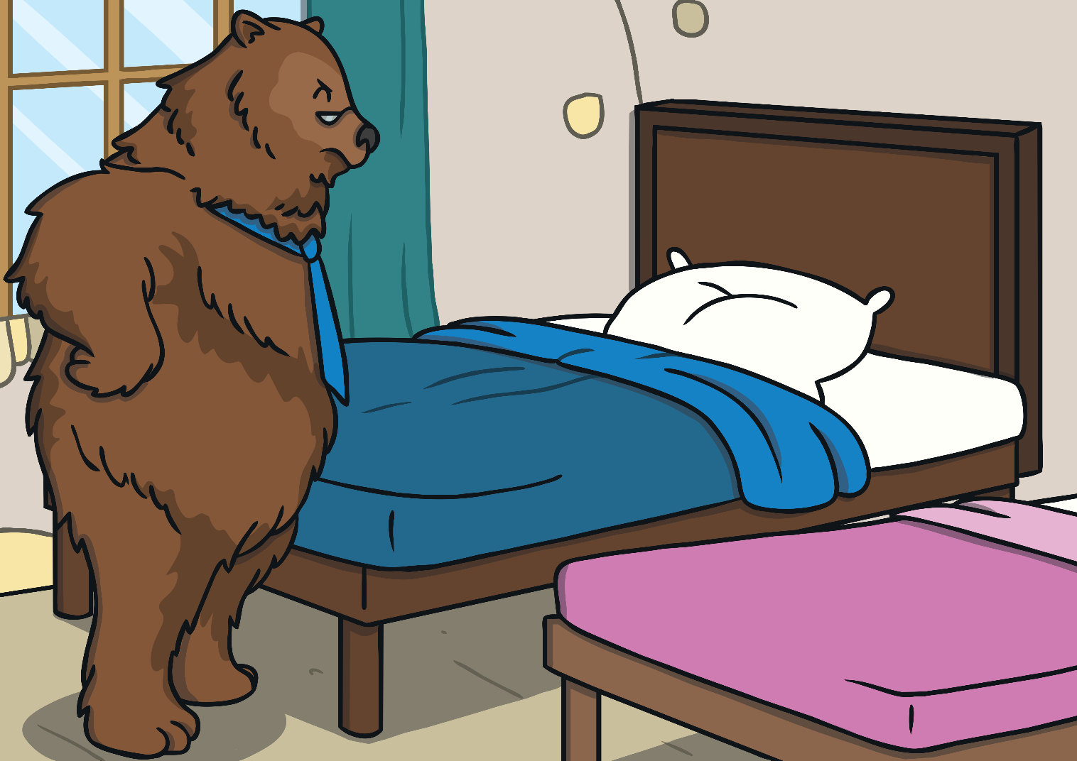
When they got upstairs to the bedroom, Daddy Bear growled, “Someone’s been sleeping on my bed.”

Slide 27
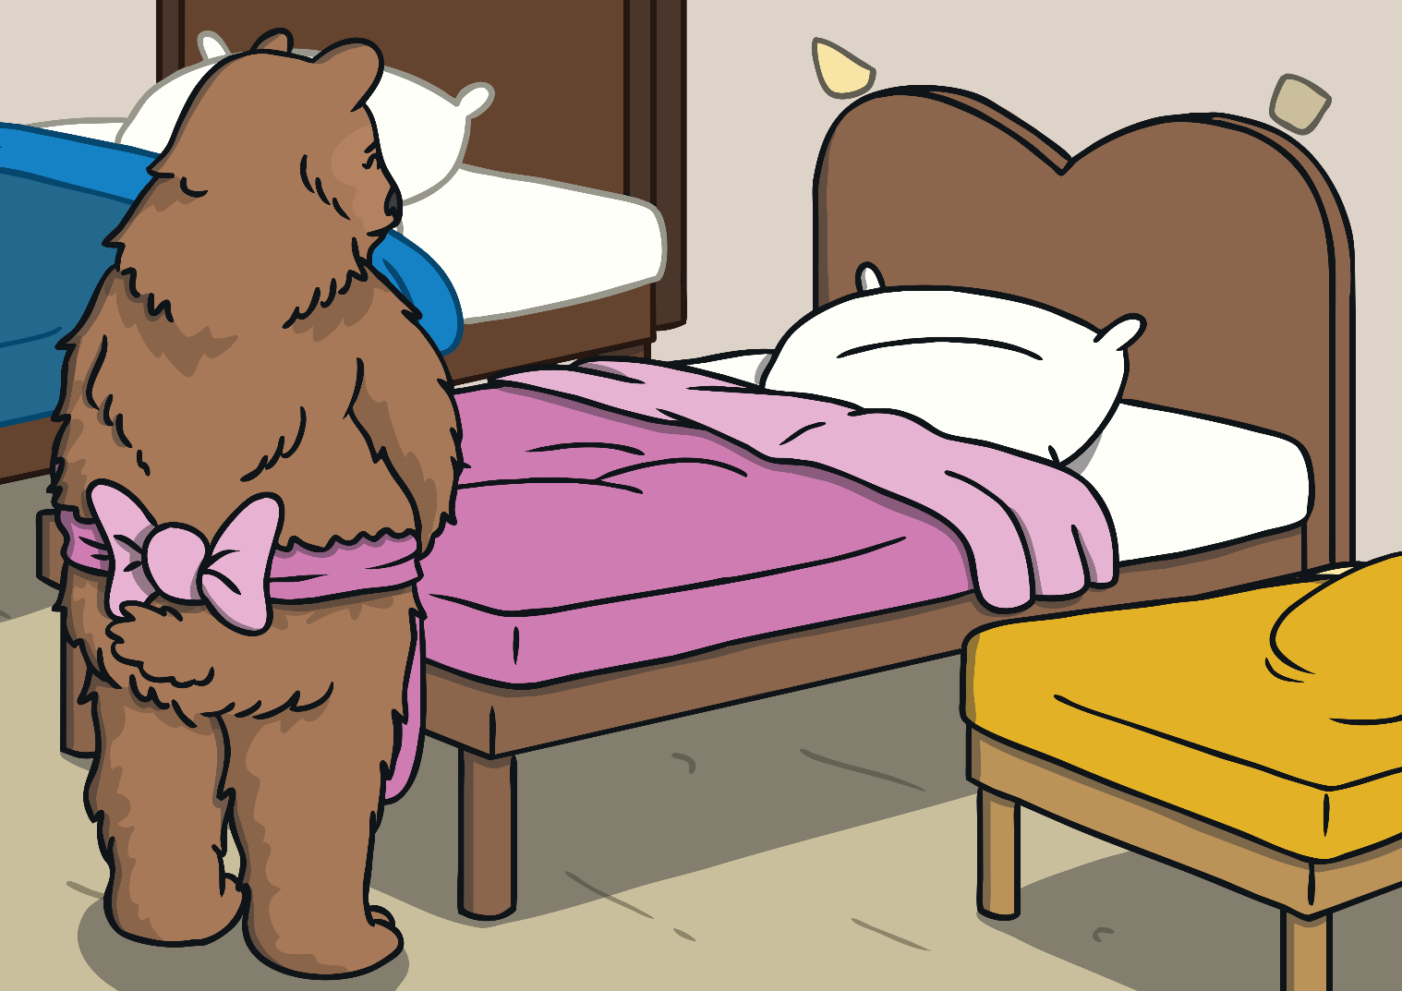
“Someone’s been sleeping on my bed too,” said the Mummy Bear

Slide 28
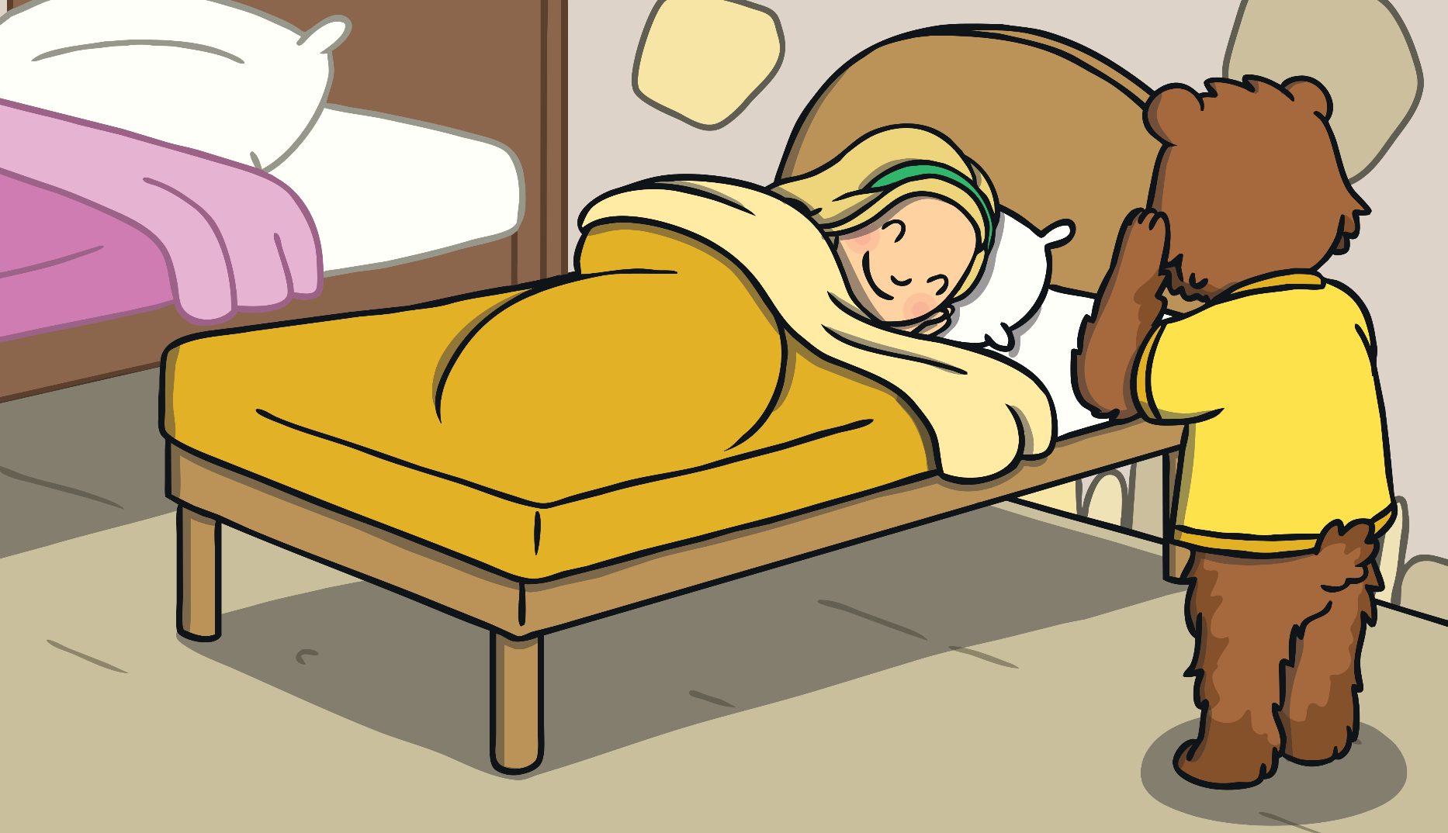
“Someone’s been sleeping in my bed, and she’s still there!” cried Baby Bear.

Slide 29
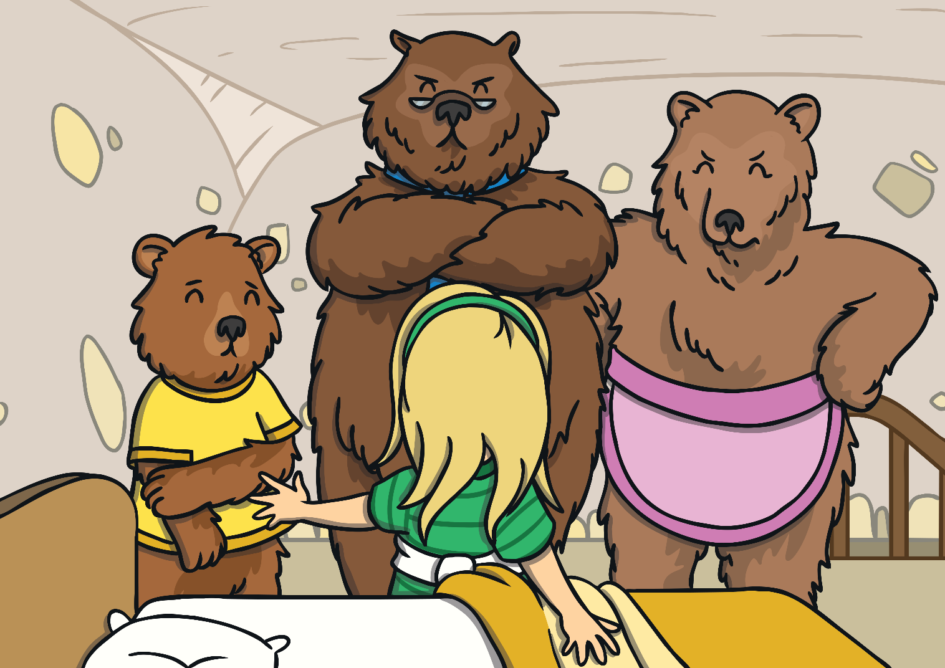
Just then Goldilocks woke up and saw The Three Bears. “Help!” she screamed.

Slide 30
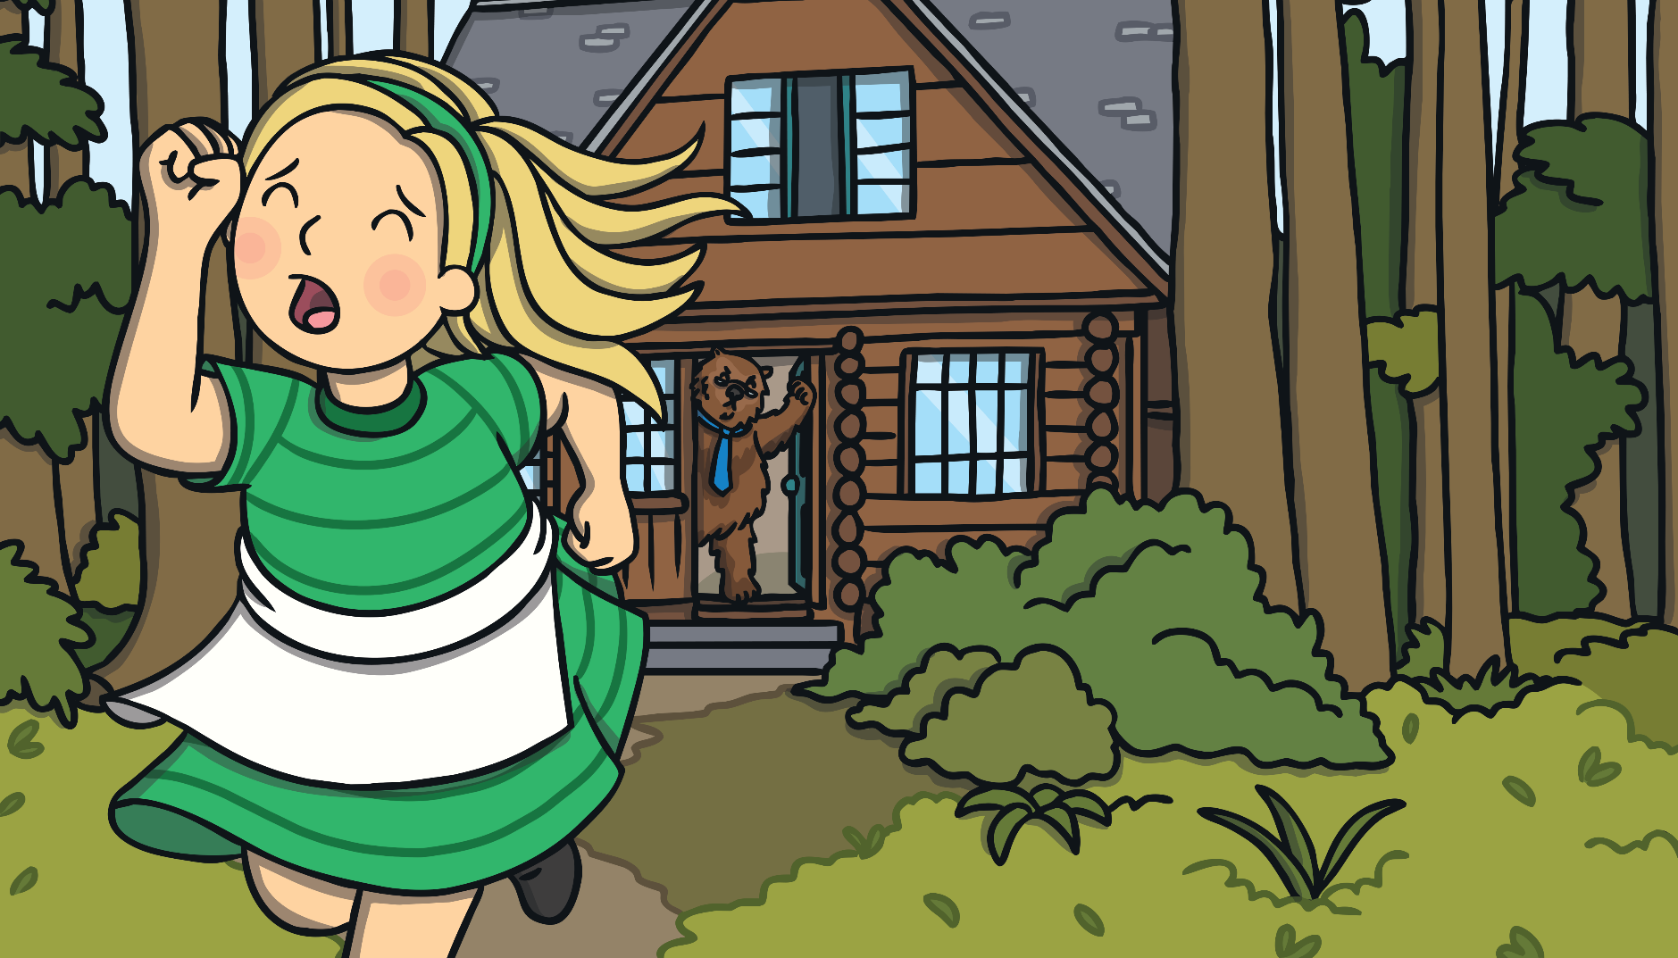
Goldilocks ran down the stairs and into the forest. And she never went back into the woods again.

Slide 31
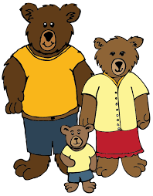
Who is your favourite character from, this story?
My Favourite character is Baby Bear.

Slide 32
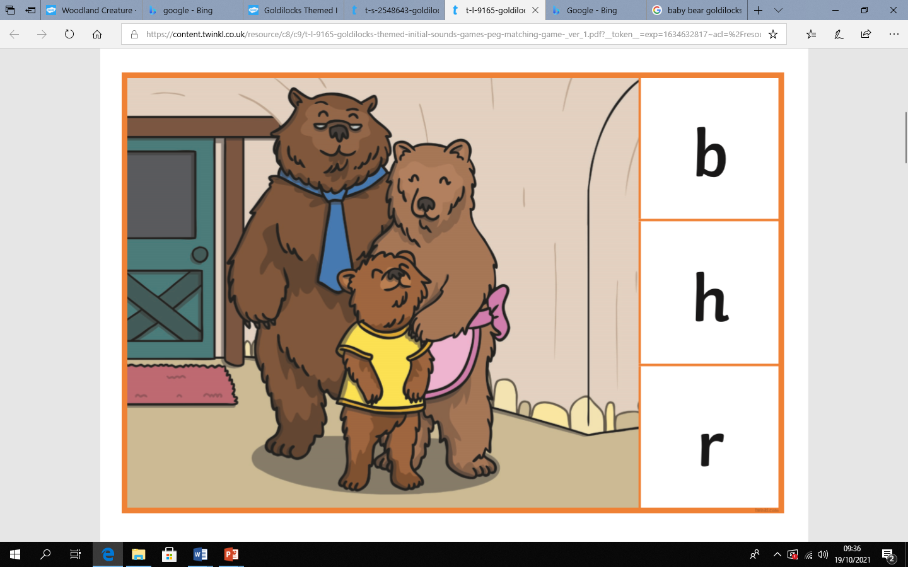
Now we are going to practise reading and recognising initial letters in a word.
What can you see in this picture?
What letter does the word start with?

Slide 33
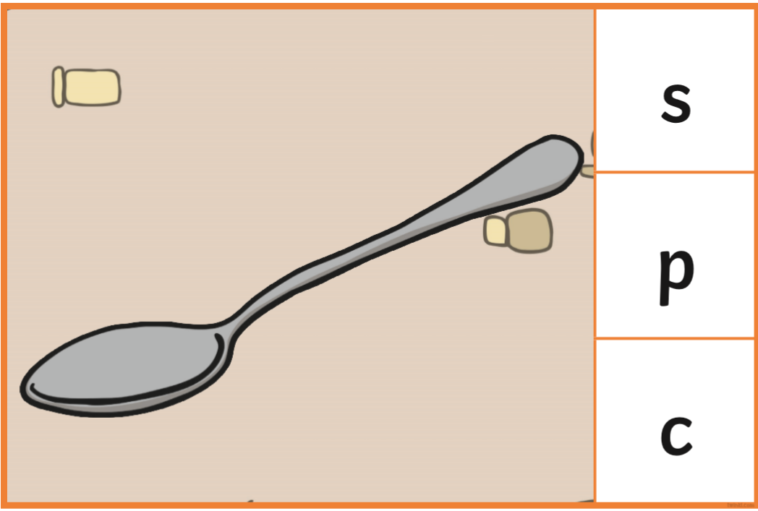
What can you see in this picture?
What letter does the word start with?

Slide 34
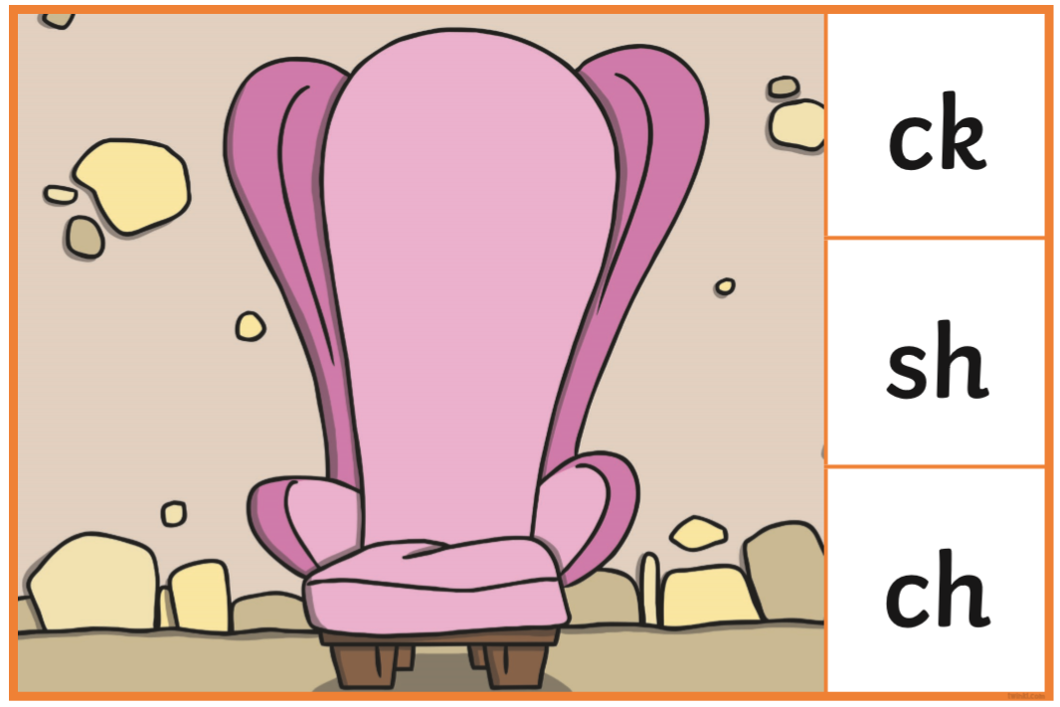
What can you see in this picture?
What letter does the word start with?

Slide 35









Now its your turn.
Who would like to tell me about a story that you
have at home?

