Slide 1

English – 20.10.21
WALT: write simple words and sentences
WILF’s:
- attempt to blend the letters in simple CVC words
- hear and write some sounds in words
Good Morning
Today we are going to be reading and writing some words together.
Lets try to sound the letters out of these words to find the missing picture.

Slide 2


cat

Slide 3

mat

Slide 4

hat

Slide 5
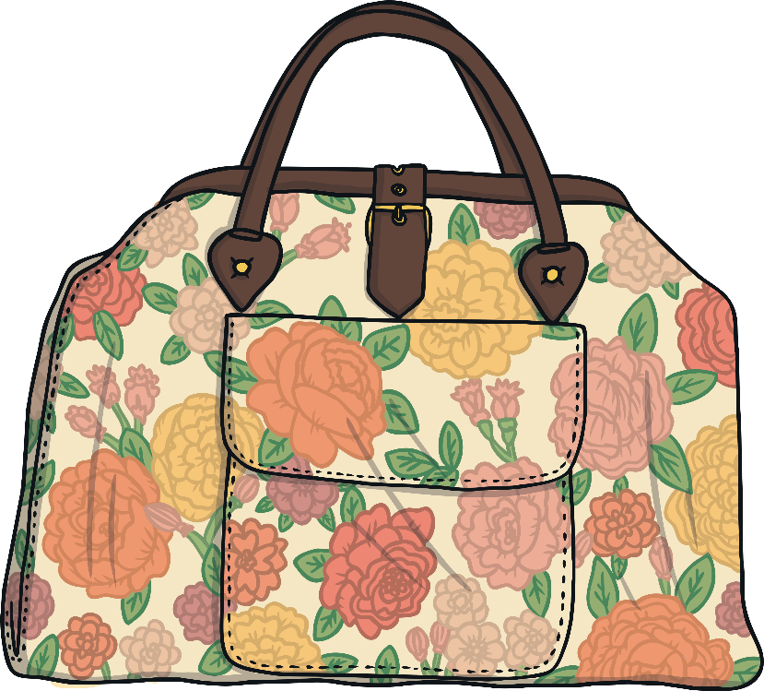
bag

Slide 6

bus

Slide 7

sun

Slide 8
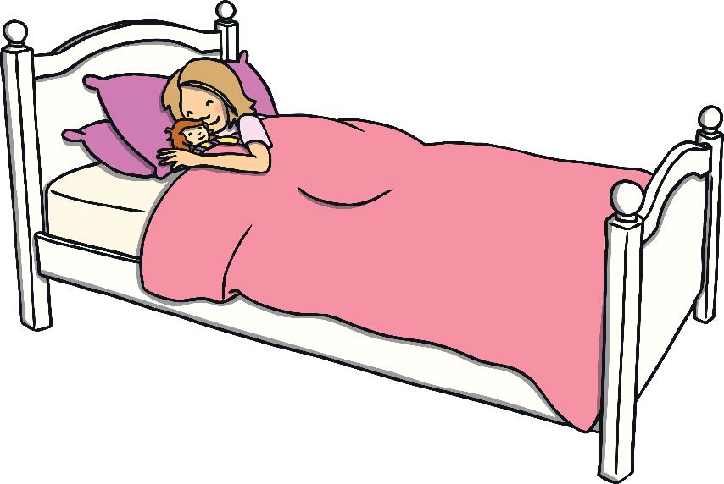
bed

Slide 9
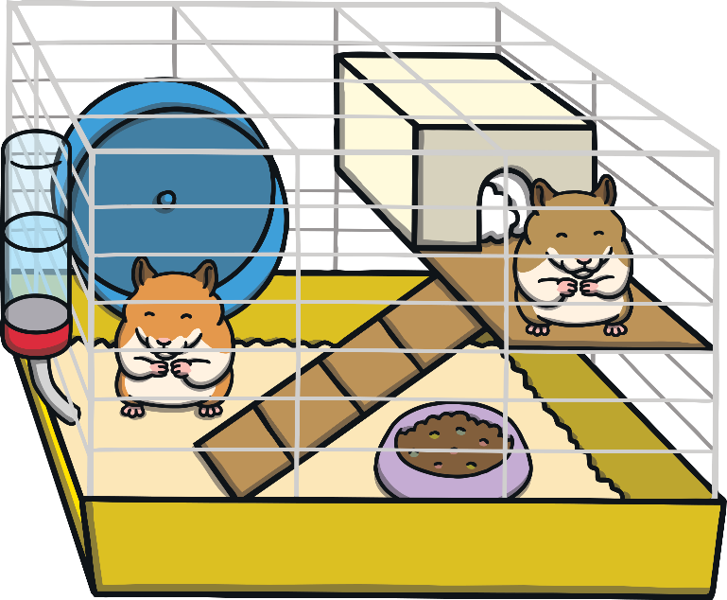
pet

Slide 10

pen

Slide 11
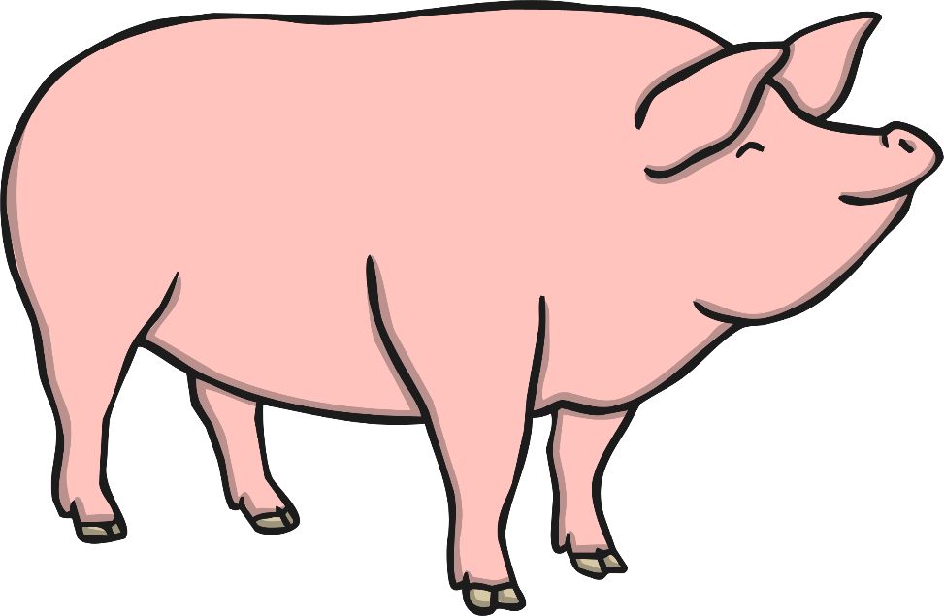
pig

Slide 12


Now lets try and spell some of these words. You need some paper/pen or a whiteboard/pen.

Slide 13
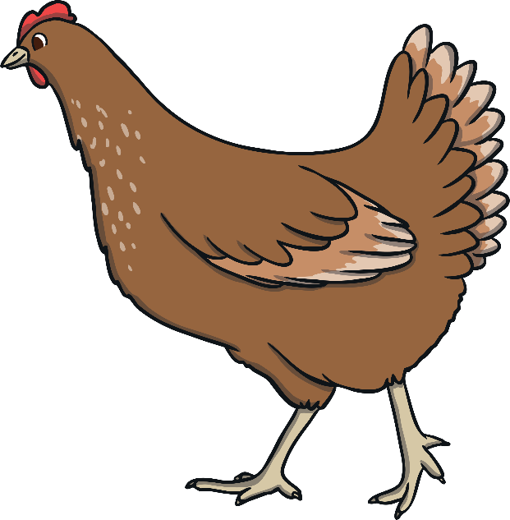
What order should the letters be in?
n
Click on the letters to spell the word
h
e
Next Slide

Slide 14
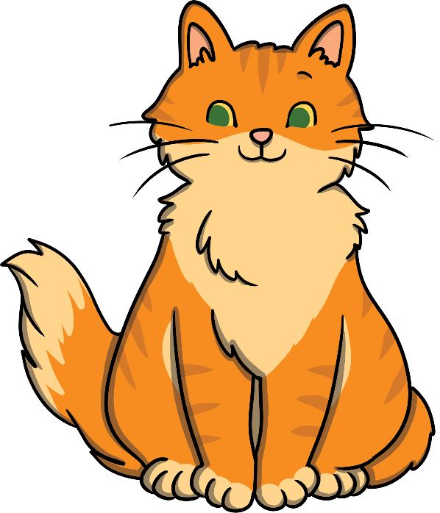
What order should the letters be in?
a
Click on the letters to spell the word
t
c
Next Slide

Slide 15
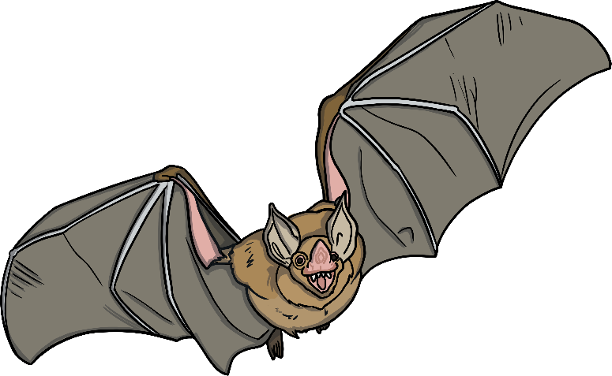
What order should the letters be in?
a
Click on the letters to spell the word
t
b
Next Slide

Slide 16
What order should the letters be in?
e
10
Click on the letters to spell the word
t
n
Next Slide

Slide 17
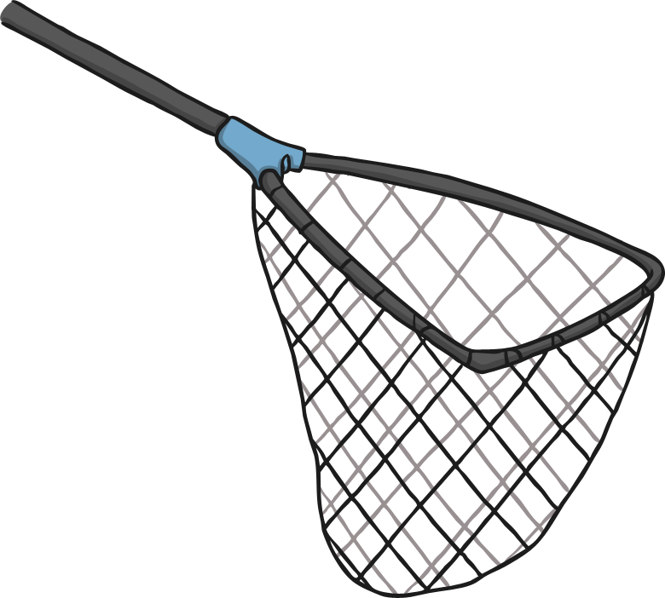
What order should the letters be in?
n
Click on the letters to spell the word
t
e
Next Slide

Slide 18

What order should the letters be in?
g
Click on the letters to spell the word
p
e
Next Slide

Slide 19
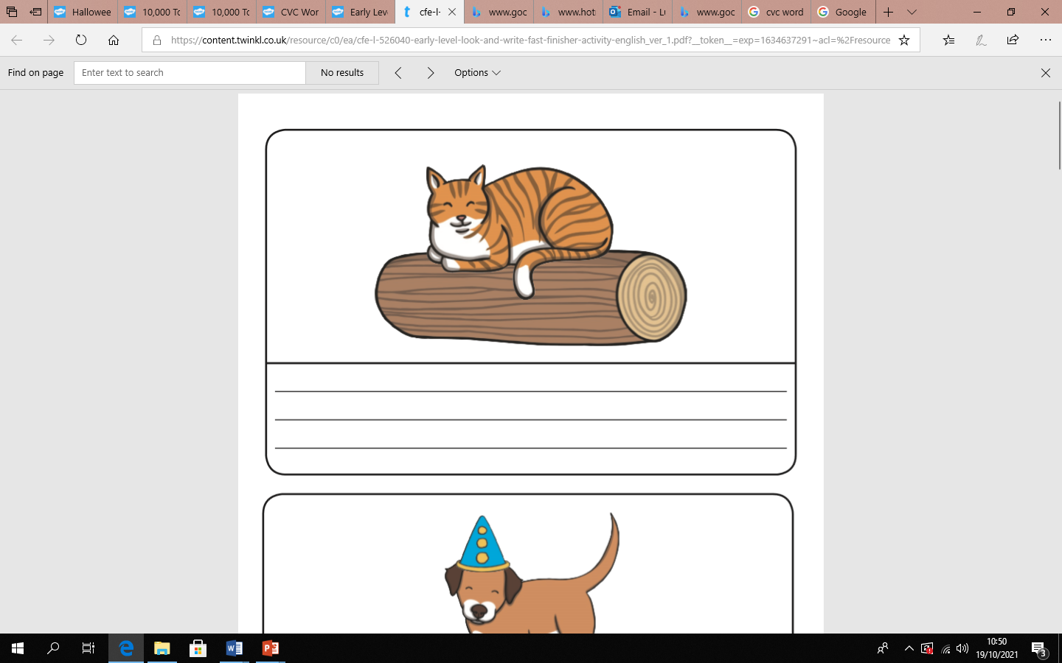
Can we put some of our new words into a sentence?
on
a
Cat on a log.

Slide 20
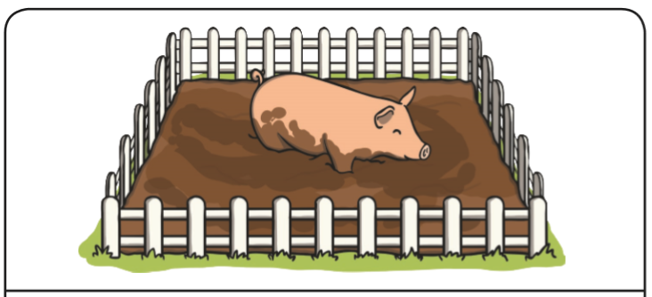
Can we put some of our new words into a sentence?
in
a
Pig in a pen.

Slide 21
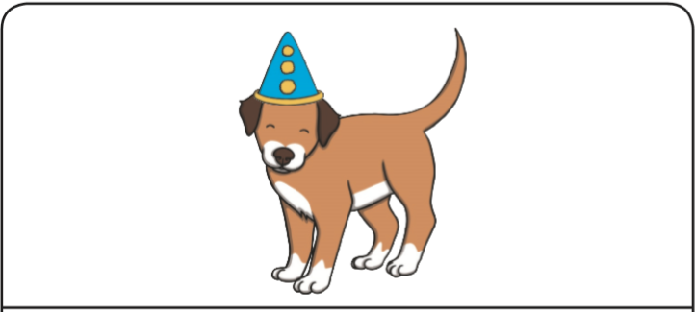
Can we put some of our new words into a sentence?
in
a
Dog in a hat.

Slide 22
Now it’s time for you work with your grown ups at home.
You could:
1). Access some of the writing activities in your home learning pack.
2) Explore the follow websites: teachyourmonstertoread.com phonicsplay.co.uk phonicsbloom.com

