Slide 1
Maths – 20.10.21
WALT: add numbers using concrete objects and pictorial representations

Slide 2
In this lesson we are going to:
Practise our number formation 1-5
Practise counting objects 1-10
Use objects to create and solve addition sentences

Slide 3





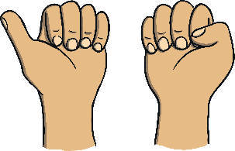
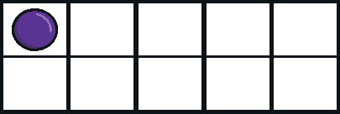
Follow the dot to make the number.
1
A downward stroke, my that’s fun.
Now I’ve made the number one.
back
next

Slide 4


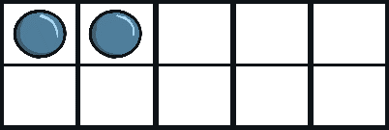
Follow the dot to make the number.
2
2
Half a heart says “I love you”.
Add a line. Now I’ve made the number two.
back
next

Slide 5

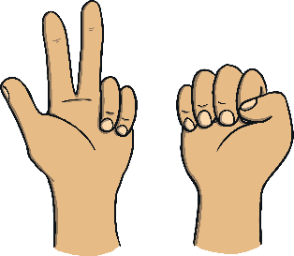
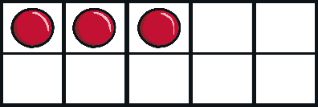
Follow the dot to make the number.
3
3
Around the tree, around the tree.
Now I’ve made the number three.
back
next

Slide 6

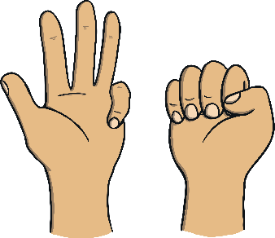
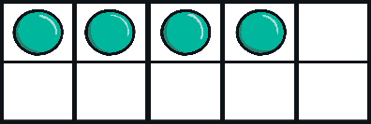
Follow the dot to make the number.
4
4
Down and across and down once more.
Now I’ve made the number four.
back
next

Slide 7

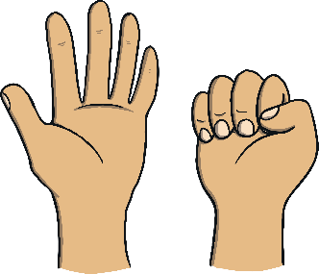
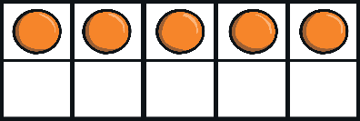
Follow the dot to make the number.
5
5
Draw the hat, the back and the belly. It’s a five.
Watch out, it might come alive!
back
end

Slide 8
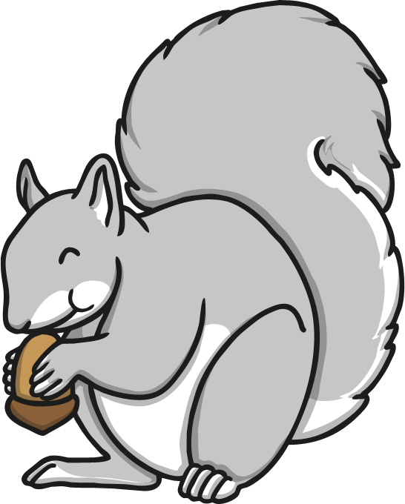
My name is Seb Squirrel. Every autumn, I like to count all of the things that I find in the woods.
Can you help me count the things I find? Then, can you find the matching number?
I hope we find some acorns on the way – acorns are my favourite!

Slide 9
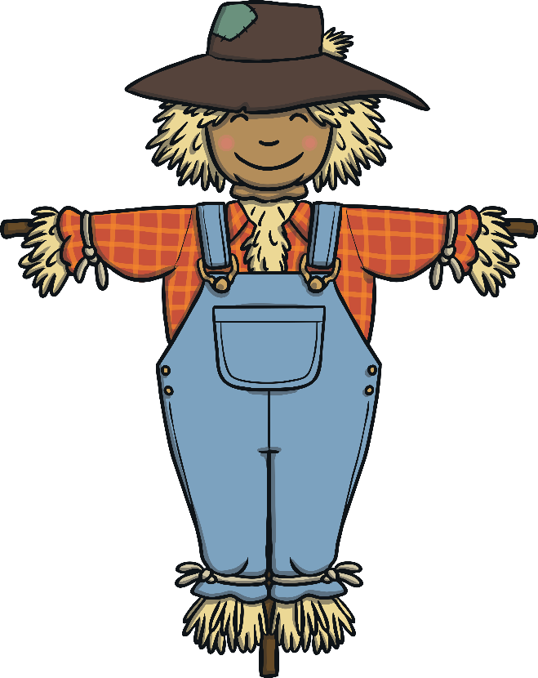
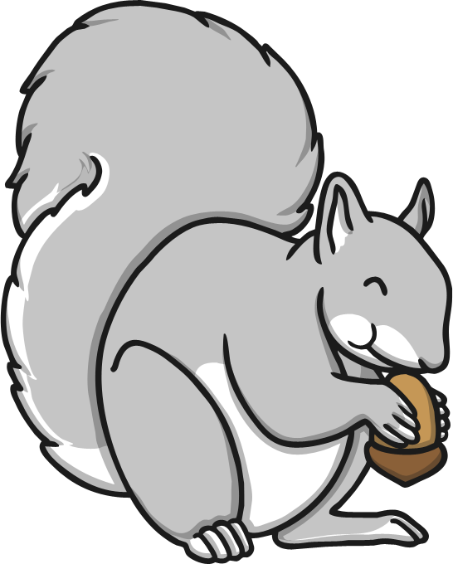
1
2
How many scarecrows can you see? Can you click on the matching number?
3

Slide 10
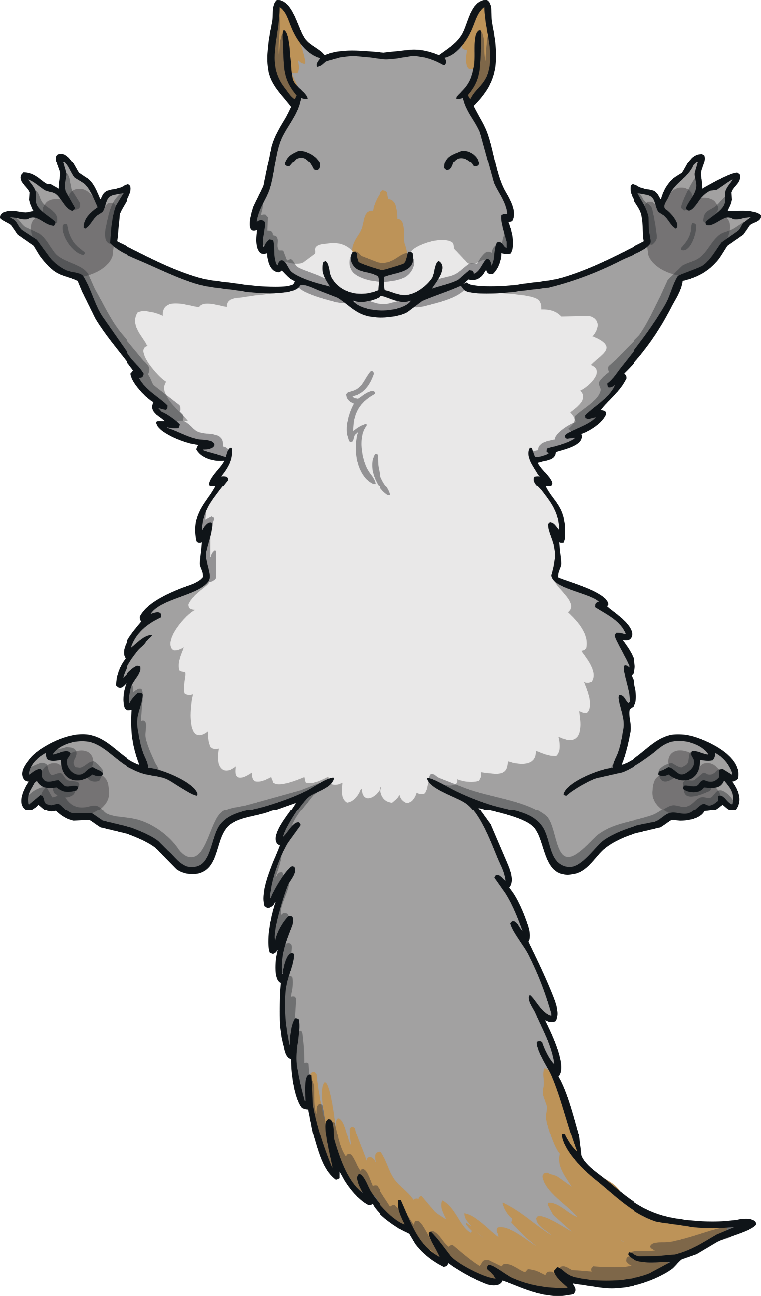
Yippee!
Well done!
Next

Slide 11
Oops!
Have another try.
Back

Slide 12
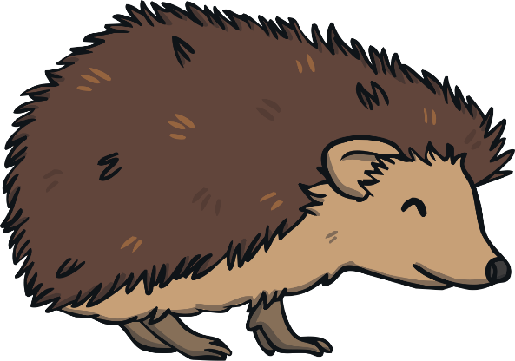
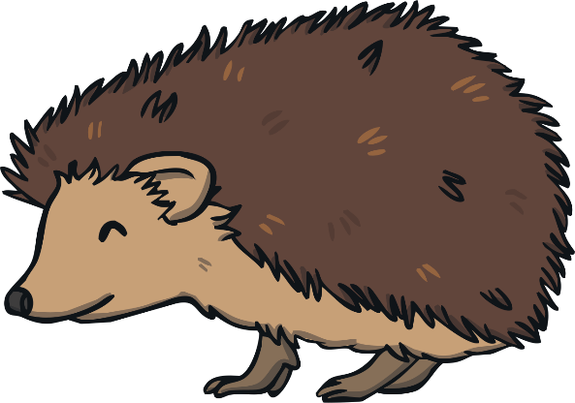
4
6
2
How many hedgehogs are there?

Slide 13
Yippee!
Well done!
Next

Slide 14
Oops!
Have another try.
Back

Slide 15
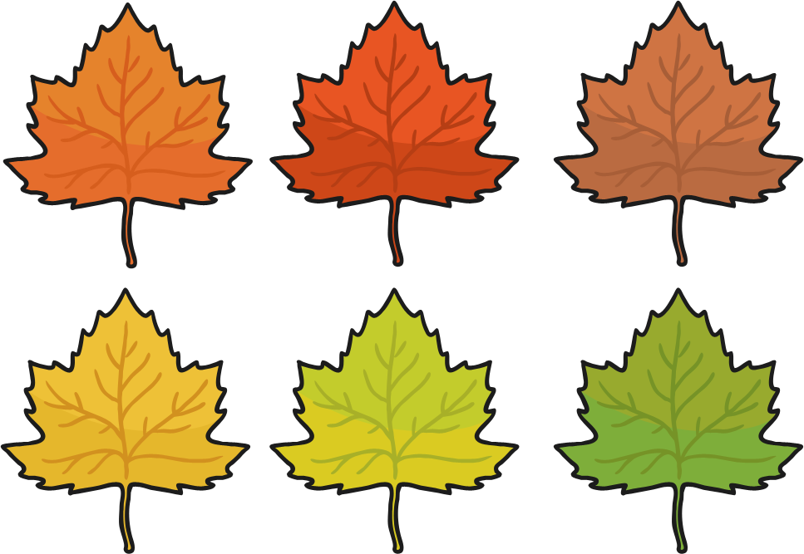
6
3
2
How many leaves can you see?

Slide 16
Yippee!
Well done!
Next

Slide 17
Oops!
Have another try.
Back

Slide 18
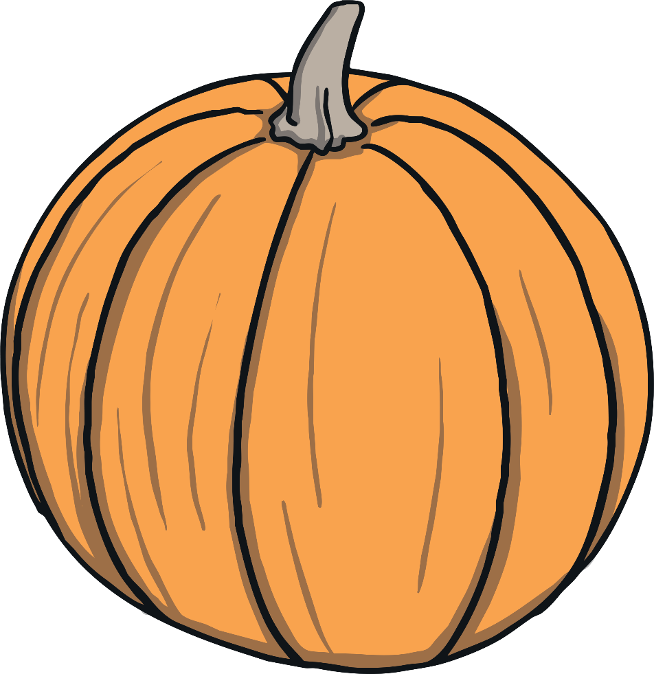
3
1
5
I love pumpkins! How many can you see?

Slide 19
Yippee!
Well done!
Next

Slide 20
Oops!
Have another try.
Back

Slide 21
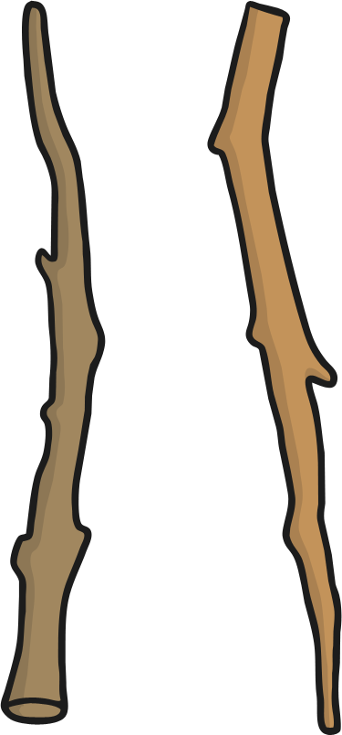
3
8
5
Can you count the fallen branches?

Slide 22
Yippee!
Well done!
Next

Slide 23
Oops!
Have another try.
Back

Slide 24
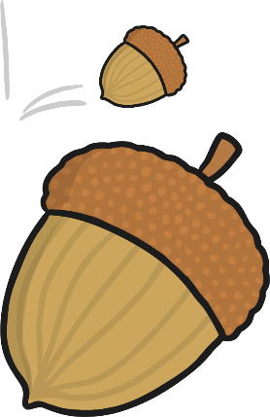
4
10
5
Finally, my favourite… acorns!
How many are there?

Slide 25
Yippee!
Well done!
Next

Slide 26
Oops!
Have another try.
Back

Slide 27

Thank you! You helped me find the yummy acorns.
You are a number superstar!

Slide 28
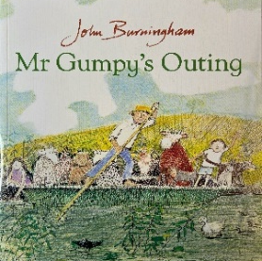
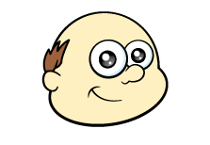
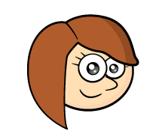

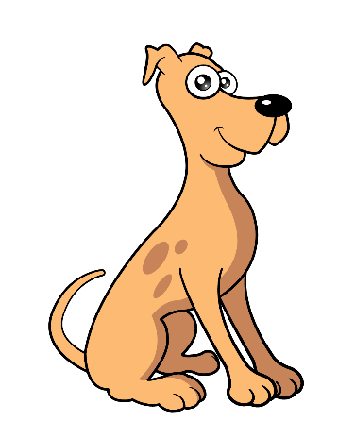
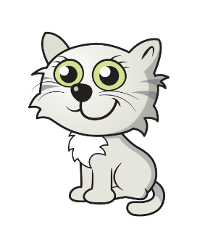
4
+ 2
6
=
Mr Gumpy has some friends on his boat…. How many friends does he have? Some more come along.. How many friends does he have now?

Slide 29

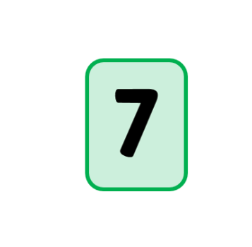


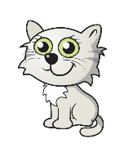


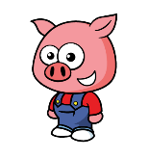

6 + 1 = 7
6
7
1

Slide 30
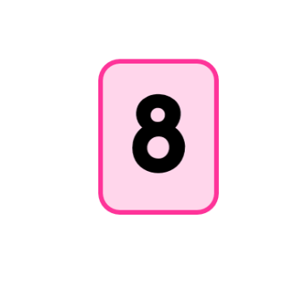
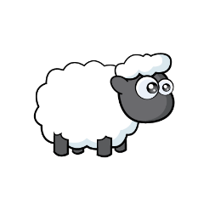

7 + 1 = 8
7
8
1

Slide 31
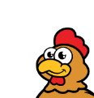
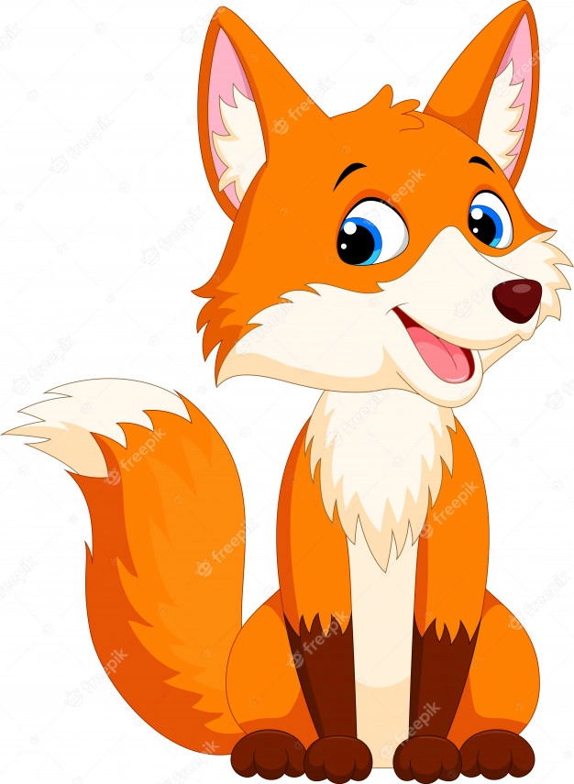
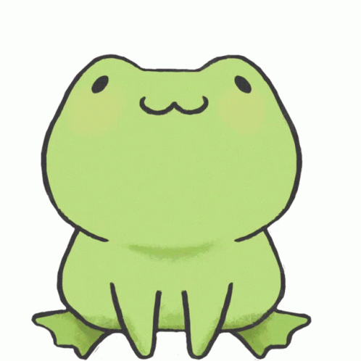
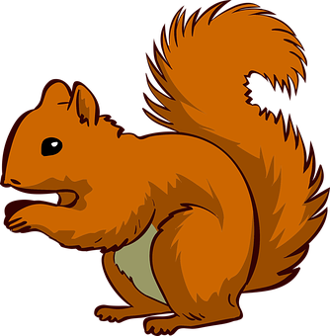
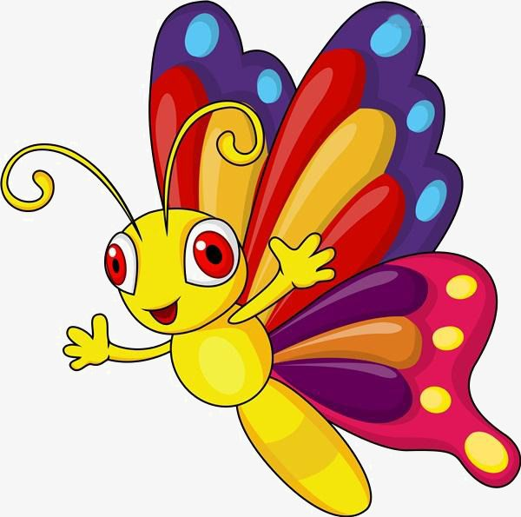
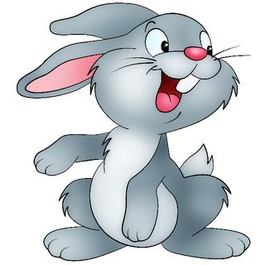

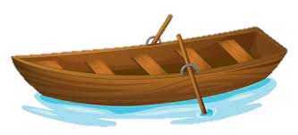
4 + 2 = 6
4
6
2

Slide 32
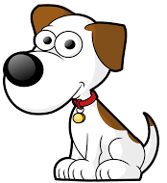
3 + 4 = 7
3
7
4

Slide 33
Use your teddies/toys/objects to solve the following number sentence:
5 + 3 = ___
5
+ 3
= ___

Slide 34
Use your teddies/toys/objects to solve the following number sentence:
2 + 4 = ___
2
+ 4
= ___

Slide 35
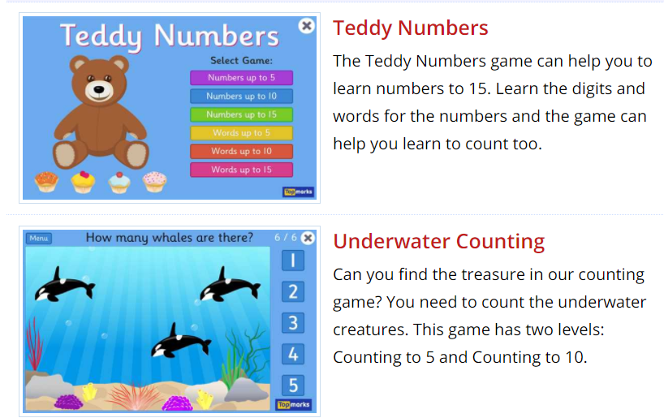
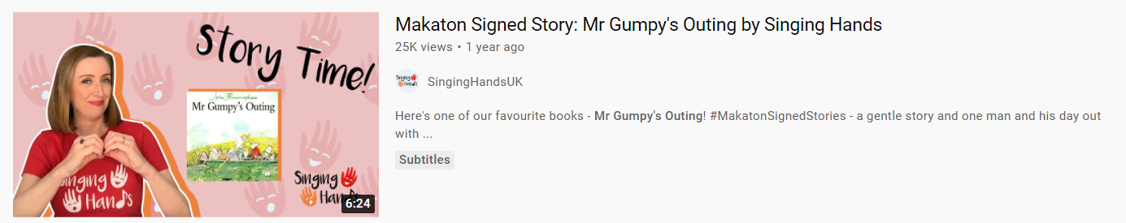
Thank you for coming! You can now access some independent learning. Some ideas are below:
1. You can access some counting and addition games on topmarks.co.uk
2. You can watch the story that this activity is based on Singing Hands on YouTube.

