Slide 1

Spring Home learning for EYFS/KS1 Learners
Nicky Rowland
Remember its important to email me and post photographs on the parent group so we can see what amazing work you have been doing

Slide 2
Daily Early Years session example
This is how we go about our day in Little Acorns - I have adapted it for home learning. Try getting into a routine early on it really will help. I have left a ‘great learning message’ at the end and music.
Morning
Hello time – sing the same hello who is in the room by physibods Activity 1 | Wake your body up ready to learn – wake and shake song Activity 2 | Communication and Interaction idea – Activity: 9/10/11/15/16 | Physical Therapy – body awareness OR Outside play & sensory diet Activity 2/3/4/5/7/8 | All areas of learning Cognition/Sensory play Activity: 6/12/13/14/15/16/17
Afternoon
Wake up sensory system – movement/song (2/3 or 4) | Communication and interaction ideas Activity:9/10/11/15/16 | All areas of learning Sensory play Activity 6/12/13/14/15/16/17 | Sensory Massage/ Story massage Activity 10/18
Sensory play builds connections within the developing brain which helps with learning
Sensory play supports language development, cognitive growth, motor skills, problem solving skills, and social interaction as well as memory

Slide 3

Activity 1 – Who is in the room?
Communication/PSED/Cognition - looking/listen/initiate interaction/learn to greet in different ways/anticipate/awareness of me and others/clapping speed and time/fun and enjoyment. Extend by using mirrors/puppets to greet and model/switches

Slide 4
Activity 2
Wake and shake – helps wake up our sensory system getting us ready for learning. Check this wake up song we use now out: Wake up Reach up
https://youtu.be/1gUbdNbu6ak
Singing hands also sing this so you can learn the Makaton too!

Slide 5

Activity 3

Slide 6

Movement
Stretching
Wherever possible spend lots of time moving, stretching, dancing and having fun!
At school we have lots of time using various pieces of equipment and on the mats. Whilst on the mats we enjoy playing instruments, exploring sensory objects and lights and playing games together.
We always begin our school day with a song called ‘Busy Body’/PhysiBods as part of our morning routine. Please enjoy this at home and stretch each part of your body along with the song and with family.
You will be able to find the song on youtube. It’s called ‘Busy Body’ by ‘Sing and Grow’. The link to song is https://www.youtube.com/watch?v=TOAcdbDFjGo.

Slide 7

Activity 4 Physibods
Physibods’ uses voice tone with music to support body and sensory awareness through music and physiotherapy. This is a real hit with some children if they like the sounds and lots of parts to it so you could do the wake up bit with one/2 parts chosen, working towards doing more bits if they like it.
https://www.youtube.com/watch?v=7TmvZ7AYMpM

Slide 8
Activity 5 - Dough Disco
This term we are going to have more fun with Dough disco this helps to improve fine muscle control. First have fun making any type of dough you can, if you are not keen use a sensory squeezy ball or partially blown up balloons. Add a safe scent…
Some children like to watch the images whilst you help them squeeze, squash…make dough/use flour and water mix/put flour in a double balloon/stress ball
Check these out:
https://youtu.be/aAo2h36DVfA - Row the boat, water ones and those who like baby shark!
https://youtu.be/klwzwKTzjpg - There’s hole in the bottom of the sea

Slide 9
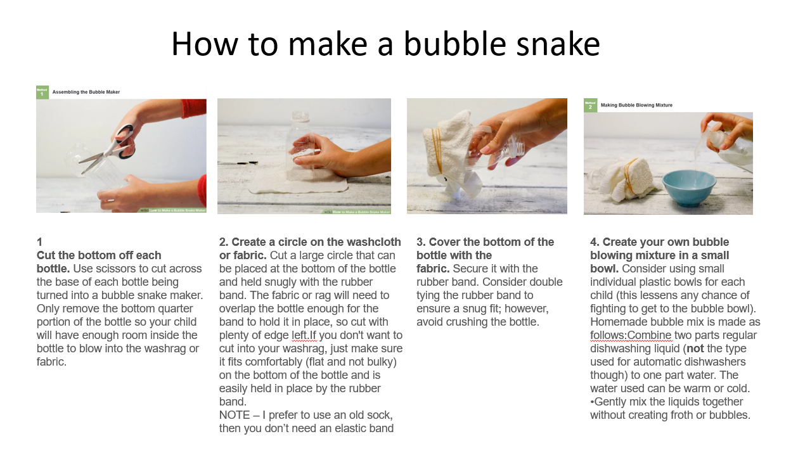
Activity 6 – physical/Early Mathematics
We are exploring water, the language of fill/empty/all gone/more/ and also what we can do with bubbles – make them move fast/slow/get bigger.

Slide 10
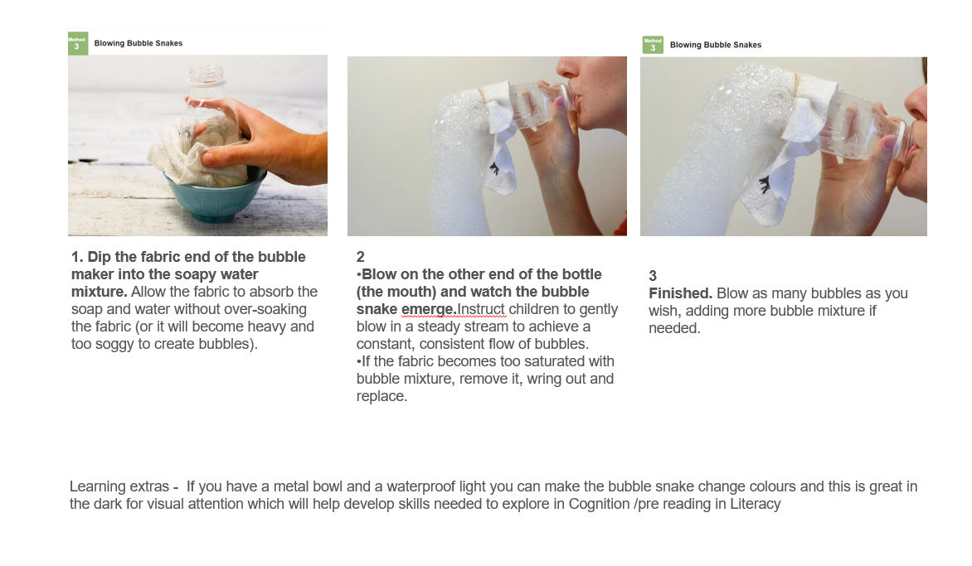

Slide 11

Activity 7

Slide 12
Outdoor learning
If you have access to an outdoor space and it is safe to do so then enjoy being outside, get some fresh air and explore!
Some idea’s for things to do outside:
Collect things from the outdoors e.g. leaves, sticks etc – can you use them to make a collage/shaky sound tub?
Ride on toys/adapted bikes - Can you practice your driving? With some support from an adult at home set up some obstacles, can you drive around them?
What can you see? Look all around your garden/safe nearby space, what can you find? Smell? Make a tub to explore.
Take pictures – can you use an ipad/phone to take pictures outside?
Talk about the weather – can you choose is it ‘hot’ or ‘cold’ – If you use a VOCA can you find words to discuss the weather?
If the weather is ok put activity arches outside, explore texture and items blowing on your face
Simply enjoy being outside and enjoy a walk!
Bubbles

Slide 13
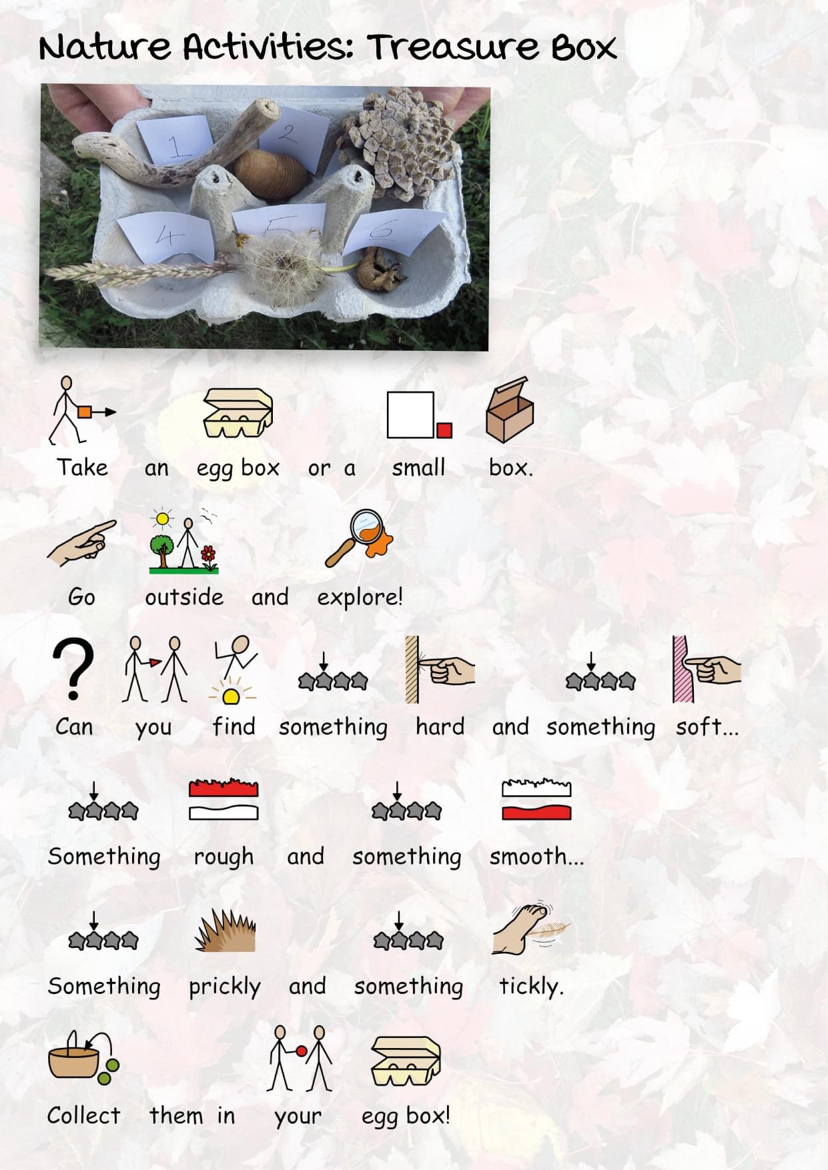
Activity 8

Slide 14

Activity 9 - Communication

Slide 15

Communication & Interaction - Sensory stories
I have sent you my focus story separately with prompts – Polar Bear - enjoy
Choosing a story
Try to find a story/book that has lots of repetition, actions and excitement to it.
In class we enjoy reading the same story over and over again so that we can really begin to understand it and anticipate what is going to happen next. In Little Acorns we like Soundplay books.
TIP - Incorporate lots of actions, signs and maybe even props to create a fun sensory story!
I have also enclosed our themed story to try…start off with just a few verses or exploring a few of the sensory props and gradually build it up.

Slide 16
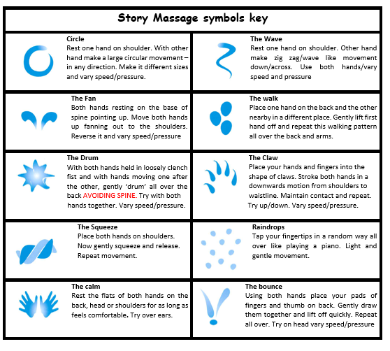
Activity 10 - Story massage
In ‘Little Acorns’ we use story massage because it combines the benefits of positive touch with fun and creativity of words – whether this is as a story, rhyme or song. It’s great to do at home too!
Ask your child if they consent to having story massage before you start. You could also ask them whether they would like their massage on a certain part of their body and if you think they like a particular move, you could ask them if they want more!
THE NEXT SLIDE SHOWS THE TOPIC ONES

Slide 17
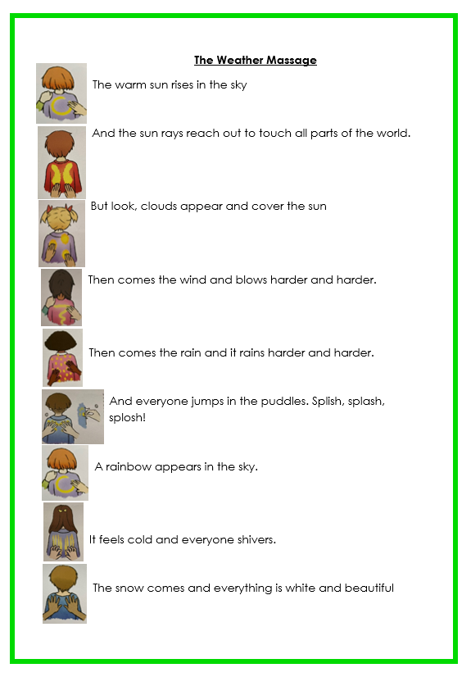
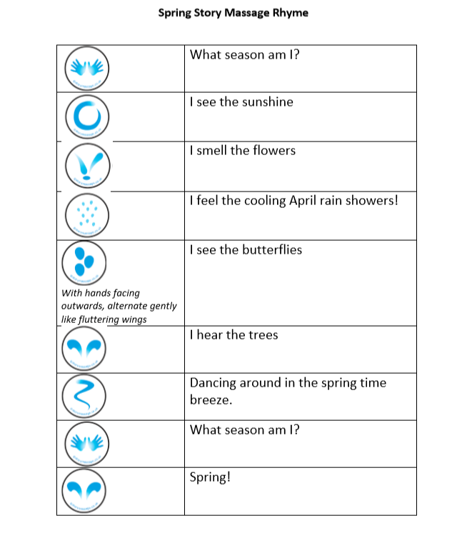

Slide 18
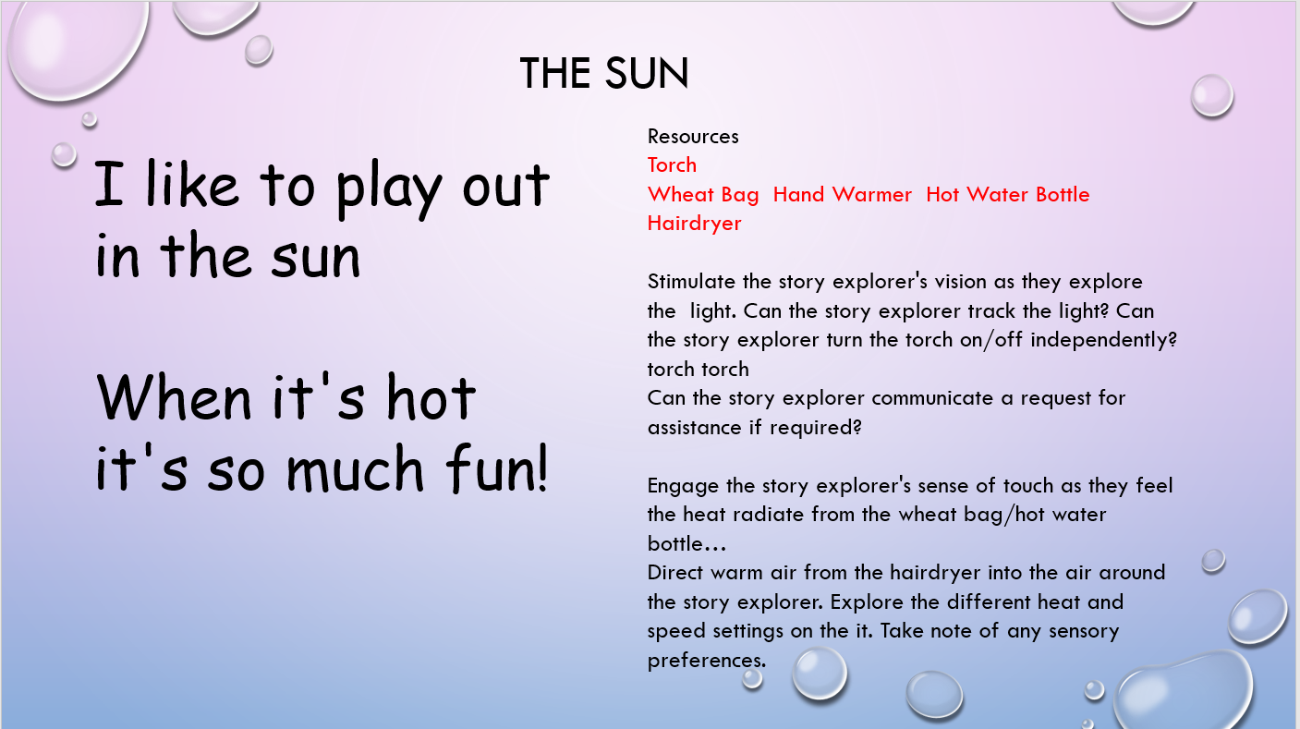
Activity 11 - Communication/Cognition Poem

Slide 19
Activity 12 – Early Mathematics
Simple Water Play
The best thing about water is it has a magnetic attraction to all of our pupils. Find some sort of tub, fill it up and have fun with some of these water play activities:
Only water- Just explore water with your hands and see what can be done with it.
Water and Ice- Explore water that is very cold!
Water and a Funnel- Pour water using different objects you may have at home.
Water and Fruit- Add cut up citrus fruits such as lemons and oranges to the water to create a different smell as your child plays.
Water and Milk Bottles- Make holes in plastic milk bottle cartons to pour water through.
Water and Foam Shapes/ Numbers/ Letters
Water and Sand- Fill your water table/tray with sand and then add water.
Water and Sponges- Have fun filling sponges making them heavy and squeezing the water out.
Water and Beach Toys- Use the bucket and spade etc in the water to pour and move the water.
Water and Small Toys- Bring some of your child's favourite toys into the water.
Water and Toothbrushes- Encourage your child to clean their toys with the toothbrushes.

Slide 20
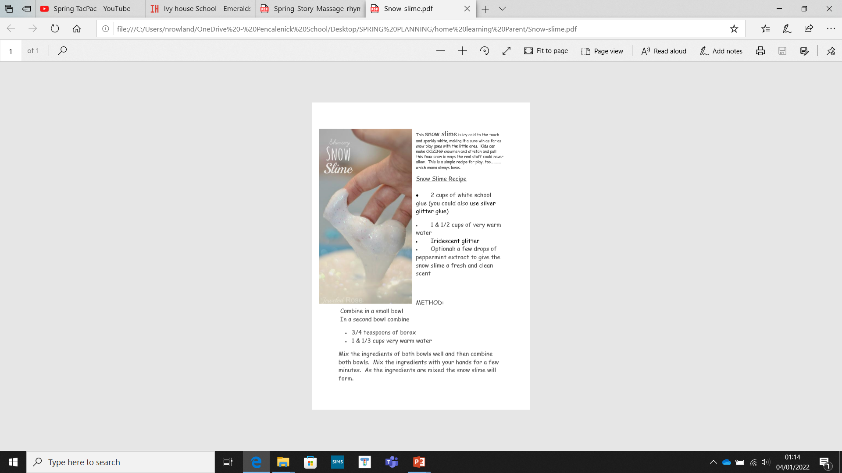
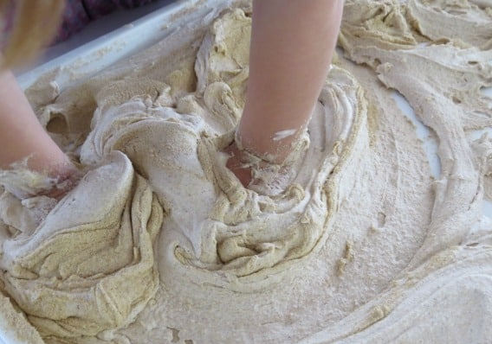
Activity 13 – Early Mathematics
Can you make different playdough/slime/sand foam together at home:
We like to experiment with a variety of textures and sensory materials link to activity 17
200ml of shaving cream
3 cups of clean play sand
Gradually add the shaving cream
and combine using hands.
Add more shaving cream
until desired consistency is made.
Count out the quantity together,
Use words like more/less/fast/slow

Slide 21

Activity 14
Explore together – helps develop communication and understanding/early cognition and key skills in exploring, look, listen and develop our senses

Slide 22
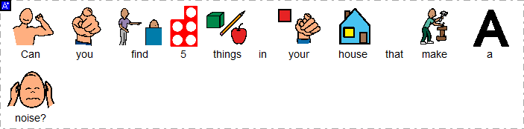

Task 15 – Communication & Interaction

Slide 23
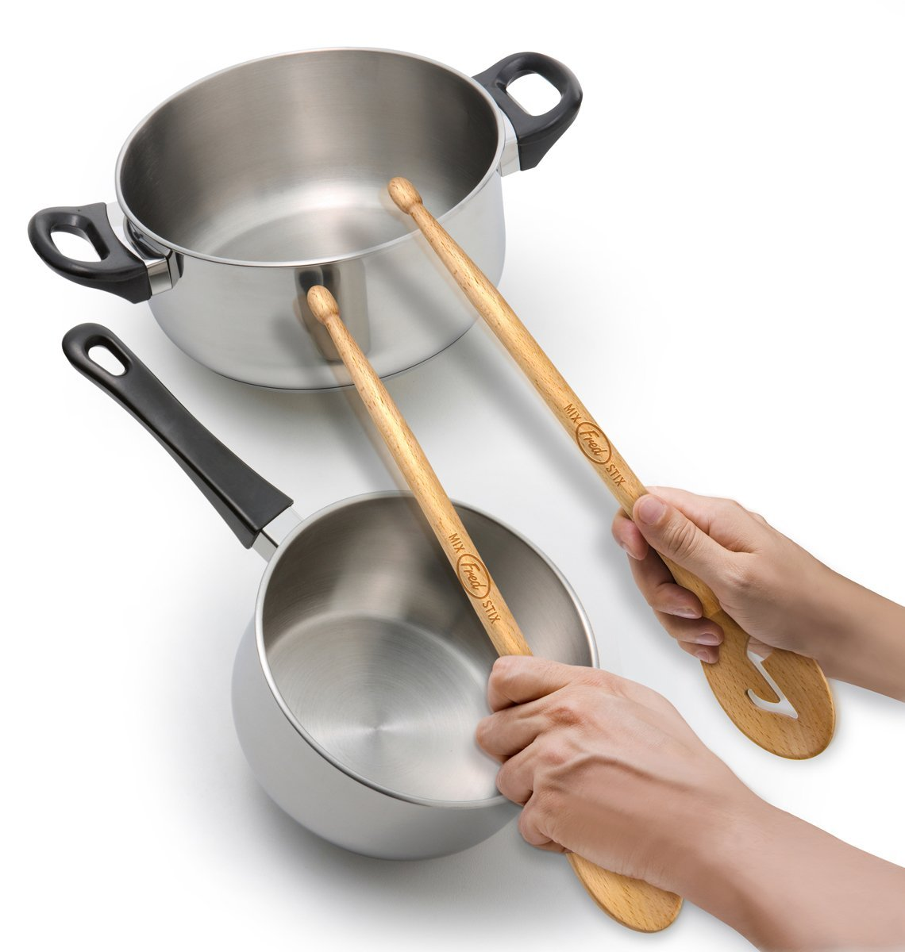
Activity 16 : Sounds – Early Phonics
Making noise and exploring sound
Explore everything around you!
Make fun with house hold utensils and objects, for example, students can work on their fine motor skills by being presented with a range of different objects – can they pick them up and drop them on the floor? Which one is the loudest?
Can they hold one object and hit it onto another, for example, using sticks or wooden spoons and hitting them onto pans to make sounds? Can you hang some up on their A frame to find and bang!

Slide 24

All areas of Learning

Slide 25

Activity 15 - Music
We love music activities/lessons at school so this would be a great way to have fun with all the family at home.- Try making some seaside instruments with just glittery water, shells, sand, water with shells, pebbles and make a band.
Do you have any instruments at home? If so, play them!
How much noise can you make? Can you play fast/slow?
Can you grasp onto an instrument?
Can you reach out for an instrument?
Can you independently explore/play an instrument e.g. shake a shaker?
Can you join in with singing a song?
Can you move/dance to a song/music? – use ribbons/chiffon scarves if you have any they are great to watch as they go up in the air and fall to the ground

Slide 26

Activity 16

Slide 27
Activity 17 - Sensory Exploration
Textures
In class we enjoy exploring lots of different and new textures as part of different activities.
Engage with different textures…
Can you touch different things in your house?
Can you explore a tray/bowl filled with different textures?
Can you pick different objects/textures up?
Can you choose which ones you like/dislike?
This term we will be exploring:
Rainbow food play
Water painting on paper
Yellow materials – tissue/cellophane wet and dry and drizzle glue (sunny art)
Sand foam and dry/wet sand warm/cold and hiding treasures in it
Foot spas with flower petals in
Coloured ice cubes/with toys in and make them melt/add juice and put lolly sticks in
Junk modelling – flowers with any items you can find, explore the materials first, have a go its about the process not the end result – have fun

Slide 28

Activity 18 – reflection

Slide 29
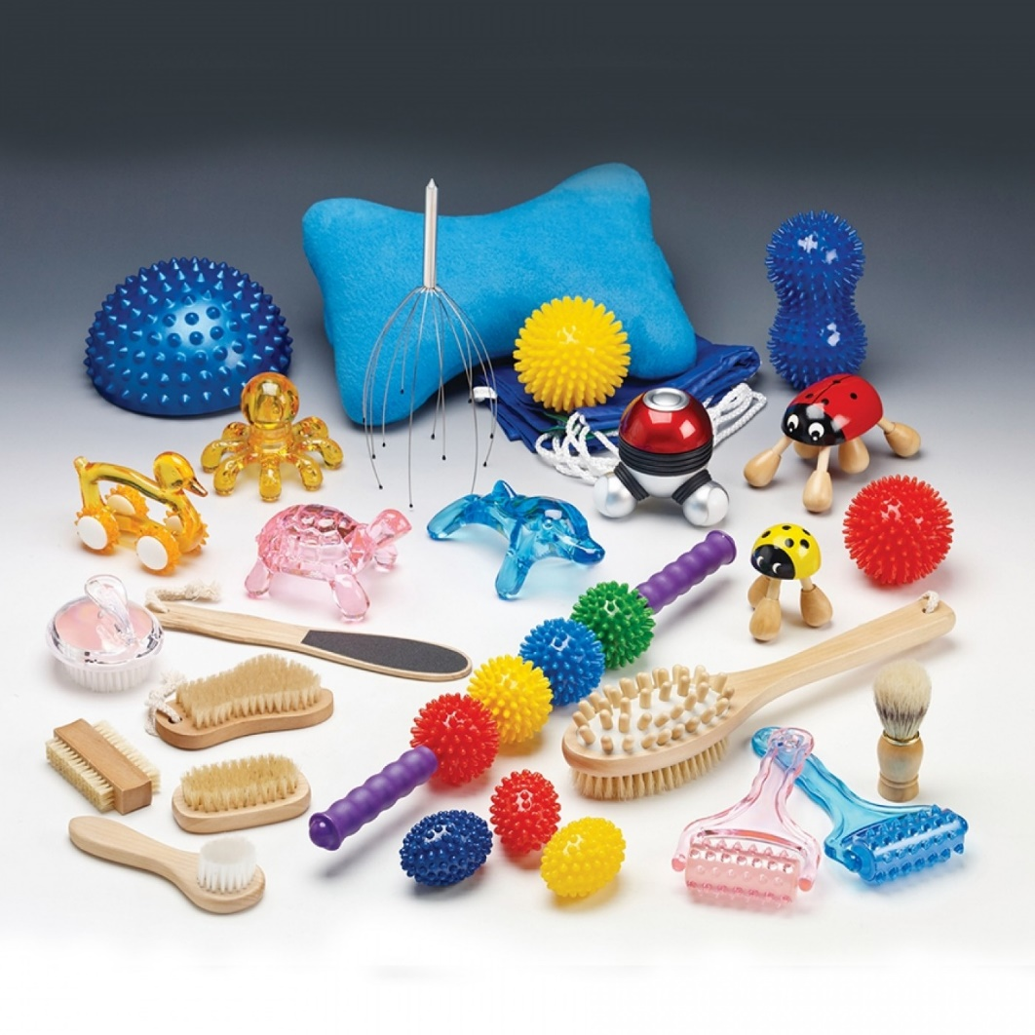
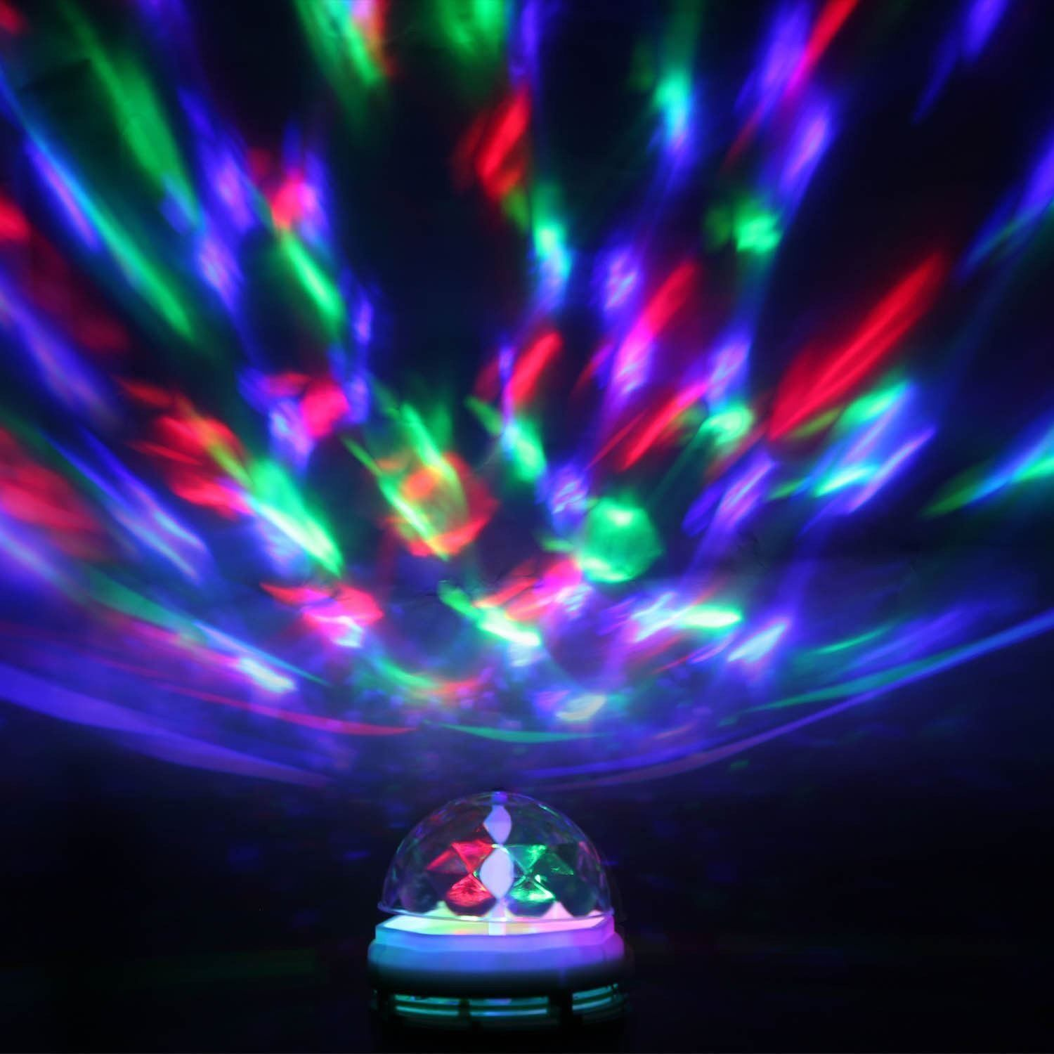
Meditation - Relax!
At school we often enjoy some sensory massage time and this will be easy and simple to recreate at home.
Play some soothing/relaxing music, find some safe cream which you ae happy to use or even vegetable oil and then enjoy some quiet time.
If you have access to any sensory lights at home then this would be a great time to put them on and enjoy them in a dark space/room.

Slide 30


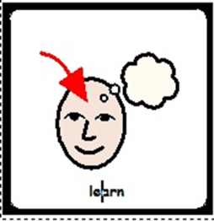
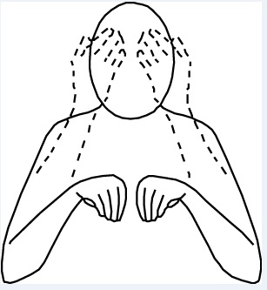
Great Learning

