Slide 1
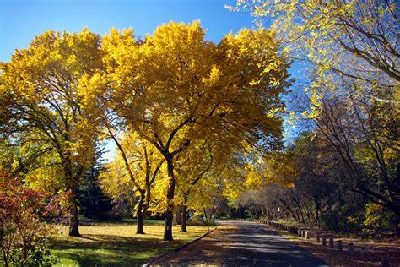
Elm Class
Remote Learning Pack
Spring 2022

Slide 2
Colours of the day
Monday | Tuesday | Wednesday | Thursday | Friday
White | Green | Red | Blue | Yellow
What day is it today?
What colour is it today?
What things can you see that are this colour?

Slide 3
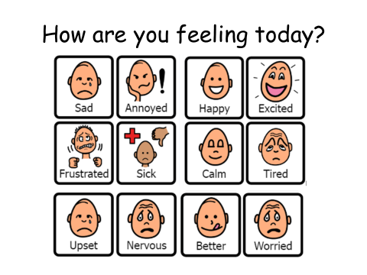

Slide 4
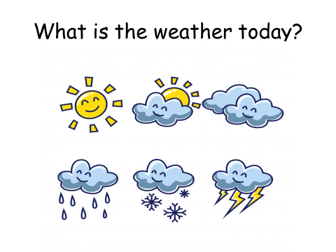

Slide 5



Elm Class – Songs
We play this song at the start of each day to remind us that we are always learning something new. | We enjoy this song when we need to pick ourselves up and have fun. | Play this song at the end of your learning session. What has your leaner done to make themselves proud?
The Morning Song - Dwayne Reed - Bing video | Makaton - Mr Blue Sky - Singing Hands - Bing video | https://www.youtube.com/watch?v=OygsHbM1UCw
Dwayne Reed- Good Morning | Singing Hands – Mr Blue Sky | Heather Small - Proud

Slide 6
Phonics and reading comprehension
https://www.bbc.co.uk/bitesize/topics/zf2yf4j | BBC Bitesize Phase 2 Phonics: use this site to support you child with Phase 2 phonics sounds.
https://www.bbc.co.uk/bitesize/topics/zvq9bdm | BBC Bitezise Phase 3 Phonics: use this site to support your child with Phase 3 Phonics sounds.
https://www.bbc.co.uk/bitesize/topics/zd63xyc/articles/zdp4pg8 | Karate Cats: KS1 level reading games and activities.
https://www.phonicsplay.co.uk/ | Phonics Play: Phase 2 through to Phase 6 (free resources and subscription)
https://www.phonicsbloom.com/ | Phonics Bloom: Phase 2 through to Phase 6 (free resources and subscription)
We have been learning about people who inspire us this term. We’ve looked at heroes in our community and on screen. We’ve enjoyed stories about Malala and how inspirational she has been to children all around the world. Read a book together and ask questions about the hero in the story. Why are they a hero? What makes a good hero?

Slide 7

Phonics: Early phonics support. Loads of fun.
Teach you Monster to Read is a phonics game that most learners love to play. If you child would benefit from this I will send you their login details in the post, with this pack. If you cannot wait, email me and I will email you their login. The game is free on laptops and free standing computers, but there is a small cost to buy the app on a tablet.

Slide 8
Awesome learning songs for you to pick and choose from. There are zillions on Youtube…
https://www.youtube.com/watch?v=o8JzH0Jq_gw | Letter shapes. Play this song, and say the letters as you see them. Use fingers to make the letters in sand, rice, paint, shaving cream etc.
https://www.youtube.com/watch?v=4KKEkVrvYVY | Learn the alphabet with song.
https://www.youtube.com/watch?v=IcO2qWARE_E&list=PL191797EAC8109FE5&index=3 | E eats everything. Silly song to support your child with their knowledge of the alphabet.
https://www.youtube.com/watch?v=e6h7LEru69U&list=PL191797EAC8109FE5&index=2 | The Alphabet of Nations. Look at an atlas together and pick out the counties names in the song. Talk about the people that live there and how they are similar and different to us.
https://www.youtube.com/watch?v=FRYw-pqSdKo | Who put the alphabet in order? Get your child to sing along. Then use it to put alphabet letters in order. Mix them up and see if they can sort them back. Etc.
https://www.youtube.com/watch?v=eQzxZlpYdew | Support with numbers 1 to 10
https://www.youtube.com/watch?v=a0flJNX_UFM | I can add. Support your child with simple additions, and sing along to the funky tune. Follow up with simple adding of household objects: pasta shapes, toy cars etc.
https://www.youtube.com/watch?v=2cg-Uc556-Q https://www.youtube.com/watch?v=mitk0Puvj2U https://www.youtube.com/watch?v=24Uv8Cl5hvI https://www.youtube.com/watch?v=z5m8BWk5LoQ&list=PL5yY0CY3rgI5muoTxImylbhCE_GVocN9I&index=17 | Revision of shapes learned last term. The first song is very familiar. The second is new, and will help them to talk about shapes and their properties. Find shapes in your home environment. Are they 2D or 3D? Count the number of sides, faces, edges and vertices.
https://www.youtube.com/watch?v=akTRWJZMks0 | Help your child to explore their feelings.
https://www.youtube.com/watch?v=OiQZNmvw8Xo | We are studying the human body this term. This song will help learn about the body organs, and what they do.
https://www.youtube.com/watch?v=Lnn8hPE9Hl0 | Explanation of what happens when you hurt yourself.

Slide 9
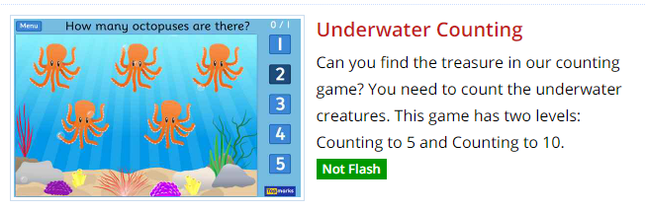
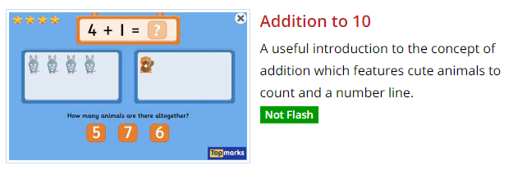
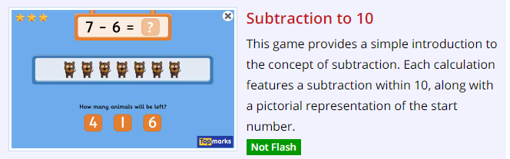
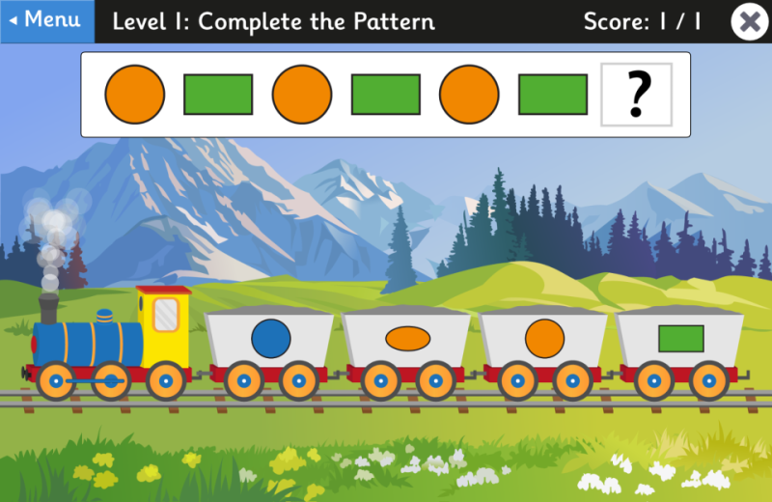
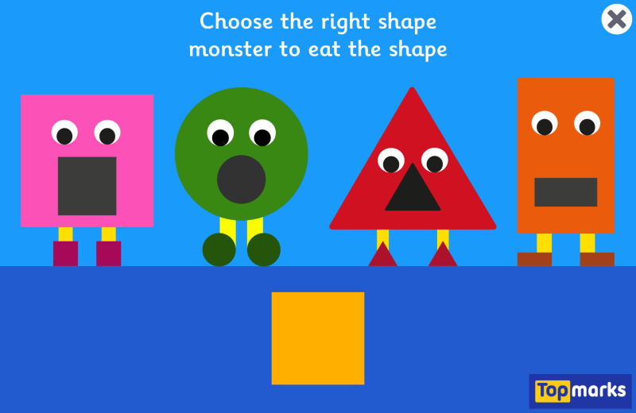
Core Skills Maths
For the next few weeks we are focusing on money. We will also revisit, shape, addition and subtraction in our core skills maths sessions.
We would like you and your child to do practical learning around these skills at home in preparation for adulthood. Food preparation, cleaning and washing up are all great opportunities to use these skills.
We are also using Maths games on the Top Marks website for counting, addition and subtraction. Your child may be familiar with the games below. There are so many games to choose from.
https://www.topmarks.co.uk/maths-games/3-5-years/counting
Fun Maths Games about Shapes, Symmetry and Co-ordinates for Kids (topmarks.co.uk)

Slide 10
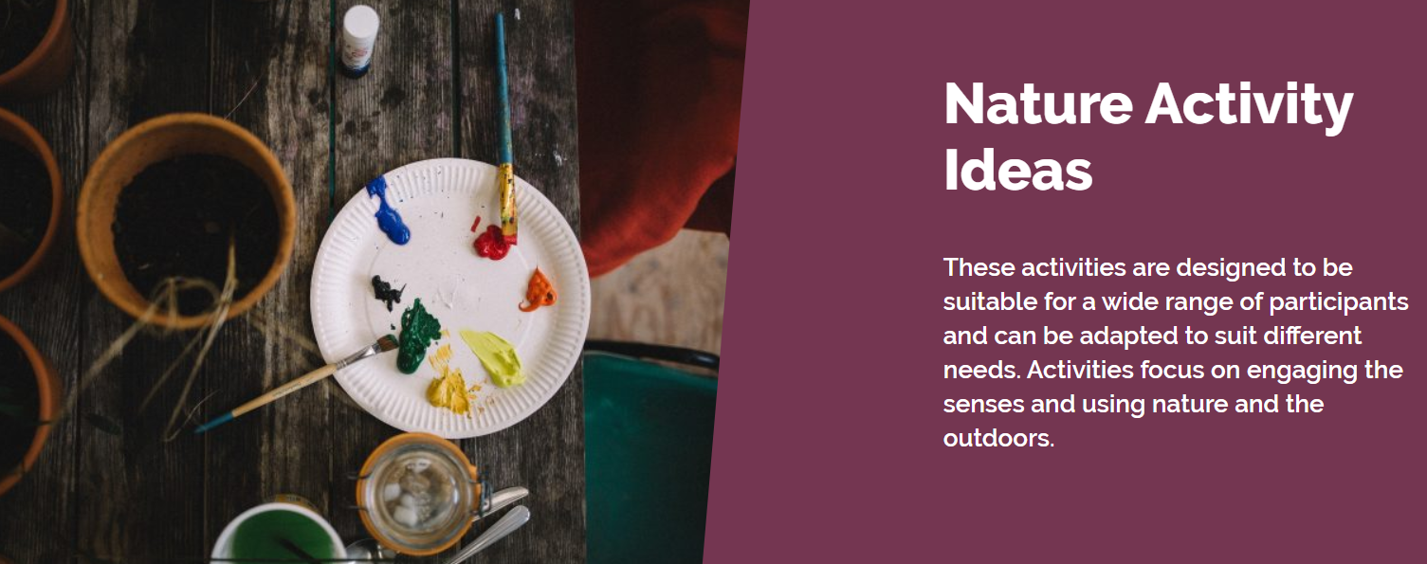
Get busy with your outdoor learning. WALT: explore the world: outdoors
For lots of ideas and step by step guides to learning outside, visit the Leaning trust website.
https://www.sensorytrust.org.uk/resources/activities

Slide 11

Our TOPIC this term is Nepal. We will look at the Napalese Flag each day, to remind ourselves of our topic. We will then look at a map of the world to locate Nepal and other countries on the map.
Use the template to make a copy of the Nepalese Flag.
Coloured pencils
Felt pens
Torn tissue paper
Paint
Etc
WALT: know about the world we live in

Slide 12
Enjoy a sensory science experience. Plant some seeds to link with our growth topic in science week.
WALT: What grows?
Explore change
Use fruit or vegetables to build a solar system to help compare the size of planets.
Igneous rock
These are formed when
molten (melted) rock or
magma is cooled.
Make edible rocks, diet and allergies permitting or create rocks from balloons, paper and discuss how rocks form and grow.

Slide 13

WALT: be creative: learn about Buddhism
Make a tree of Friendship for your family.
Make hand prints for all your family and friends.
Cut them out and make a tree display on the wall.
Write the names on the hands, if you like.
Have a conversation every day about how we can be kind to / help our friends and family.
Resources: paint, paint brushes, paper, scissors, glue / blue-tack

Slide 14
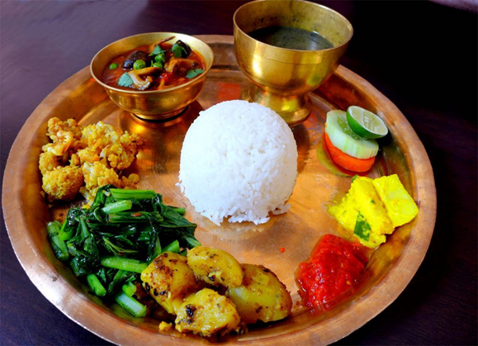
WALT: cook a ‘simple’ meal
WALT: improve our fine motor skills
WALT: make / eat healthy choices
WALT: use good personal hygiene
WALT: look after our environment
As you know, cooking is such fun. This term we are learning all about Nepalese food. How about joining in at home?!
Recipe 1: Thupka (Himalayan soup): https://www.youtube.com/watch?v=UxiWkgidJds
Recipe 2: Aloo Sanheko (Potato salad): https://veganuary.com/recipes/nepalese-potato-salad-aloo-sandheko/
Recipe 3: Cauliflower Pakora: http://nepalitummy.blogspot.com/2014/03/cauliflower-pakoras-recipe.html#.Ydb0lmjP1PY
Recipe 4: Chicken Choila: http://nepalitummy.blogspot.com/2013/08/chicken-choila-requested-recipe.html#.Ydb1CWjP1PY
Recipe 5: Hot dog Chilli: http://nepalitummy.blogspot.com/2016/02/nepali-style-sausagehotdog-chili-recipe.html#.Ydb1uGjP1PY
Recipe 6: Rice pudding: http://nepalitummy.blogspot.com/search?q=pudding#.Ydb1-GjP1PY

